Slide 1

Metal 3D Printer Commissioning
Nathan Krikawa | Nolan Hann
Mechanical Engineering Capstone, NAU
April 25, 2025

Slide 2

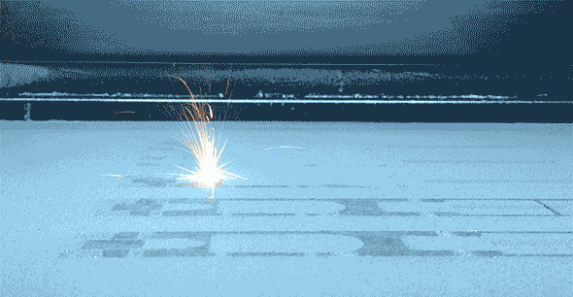
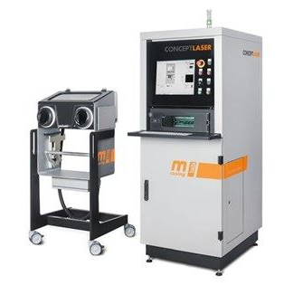
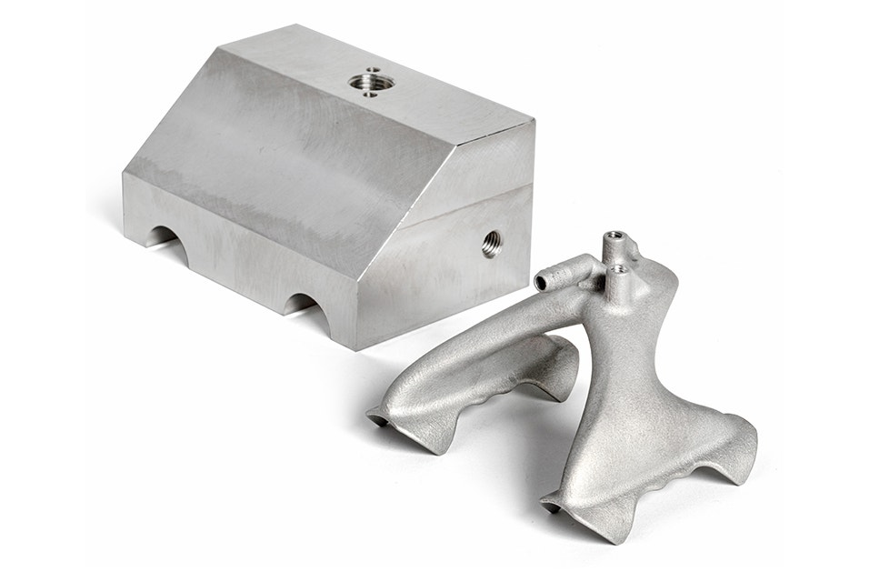
Project Description
Overview:
Commissioning of Concept Laser Mlab Cusing R metal 3D printer
Donated by Honeywell to NAU’s ME department for the IDEA Lab
Our Job:
Install and restore printer to proper functionality.
Evaluate printed specimen against machined counterparts
Print final part as part of assembly using topology optimization
Create instruction manual for training purposes in preparation for work orders and ME286L curriculum expansion
Figure 2: Laser Powder Bed Fusion
Figure 1: Concept Laser Mlab Cusing R
Figure 3: Redesigned Aluminum Gripper
Notes:
Overview:
Installing and Troubleshooting a M100LabR Concept Laser PBF Printer
Printing and evaluating parts and specimens (ie Stress-Strain, Thermal Management)
Creation of a user manual and short curriculum for ME286L
Included is the printer itself, powder mixer, powder trolley, and various powdered alloys for use with the printer
Location of set-up: CEIAS IDEA Lab, Room 116A

Slide 3
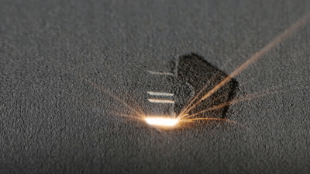
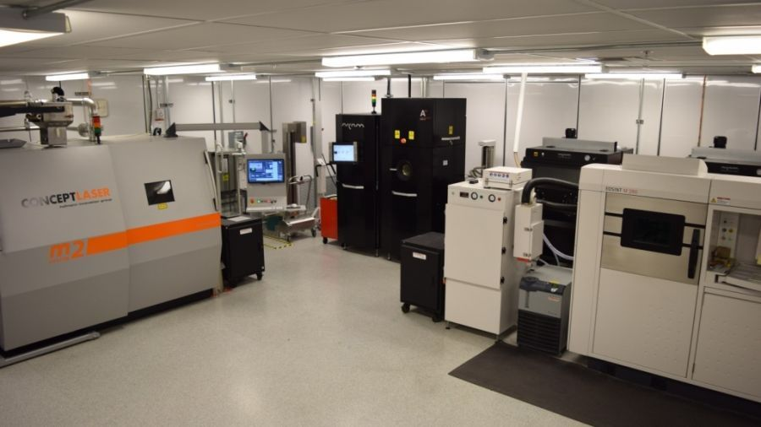
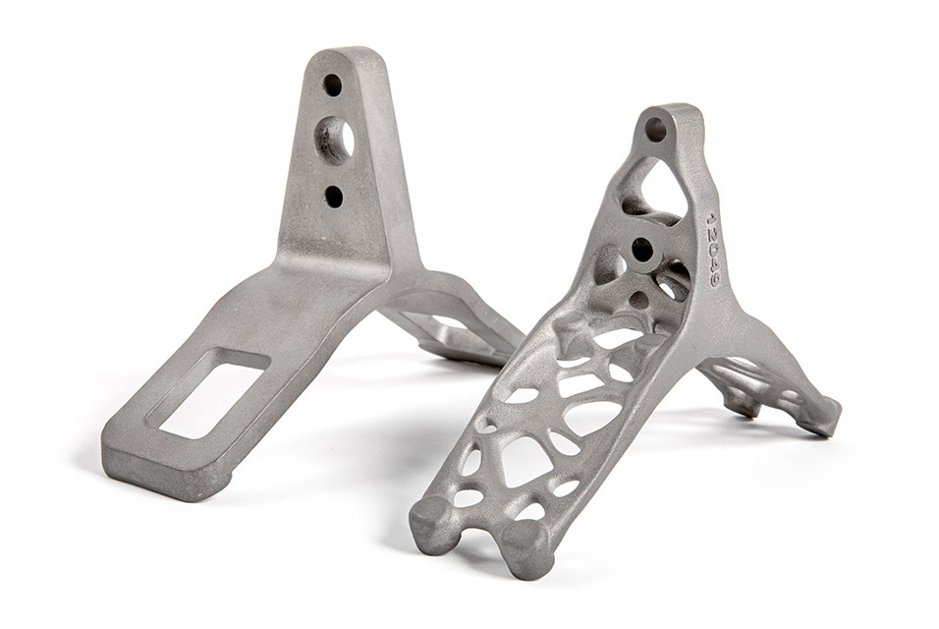
Background & Benchmarking
Metal 3D printing with laser powder bed fusion (LPBF)
Melts powdered metal layer-by-layer with a layer height of 15-50μm with 100W fiber laser
Strong, lightweight, complex design freedom – topology optimization. Small build volume
GE Additive Concept Laser Mlab Cusing R, Honeywell Aerospace, UA, ASU
DED – Powder, wire
Binder Jetting – Binding polymer powder bed, sintering
BPE – Binding polymer extrusion
Figure 4: One Layer of LPBF
Figure 5: Honeywell Additive Lab
Figure 6: Aircraft Bracket, 40% Lighter
Notes:
U of a and Asu, Honeywell manufacturing

Slide 4
Research, Requirements, and Strategy
Section 1:

Slide 5
Design Requirement Summary
Engineering Requirements
Customer Requirements
# | Requirement | Units | Targets
ER1 | Materials Tested | Al, SS 316L, Ti, Bronze | One
ER2 | Final Print Material | Al, SS 316L, Ti, Bronze | SS 316L
ER3 | Final Print Volume | mm^3 | <90x90x80
ER4 | Power | V, A | 240V, 16A
ER5 | Inert Gas | N, Ar, bar, purity | 2 bar Ar purity >=2.5
ER6 | Young's Modulus Tested | GPa | 193
ER7 | Dog Bone Size | mm | 65
ER8 | Airtight Gas Supply | N/A | No audible leak
ER9 | Build Plate Alignment | N/A | Even material distribution
ER10 | Printed Part Tolerance | mm | ±0.2mm
# | Requirement | Description
CR1 | Ease of Use | Easily accessible to IDEA Lab managers, Instruction manual and supplementary instructions at hand
CR2 | Safety | Printer fully and properly installed, safety signs posted, PPE available, instruction manual at hand
CR3 | Time | Fully installed by the end of the spring 2025 semester
CR4 | Successful Installation | Printer fully operational, all technical issues addressed
CR5 | Tensile Test Results | All test specimen tested; all results analyzed
CR6 | Final Part and Assembly | Final part printed and assembled into greater assembly
CR7 | Instruction Manual | “First print” instruction manual complete with comprehensive steps and files attached
Notes:
Overview:
Installing and Troubleshooting a M100LabR Concept Laser PBF Printer
Printing and evaluating parts and specimens (ie Stress-Strain, Thermal Management)
Creation of a user manual and short curriculum for ME286L
Included is the printer itself, powder mixer, powder trolley, and various powdered alloys for use with the printer
Location of set-up: CEIAS IDEA Lab, Room 116A

Slide 6
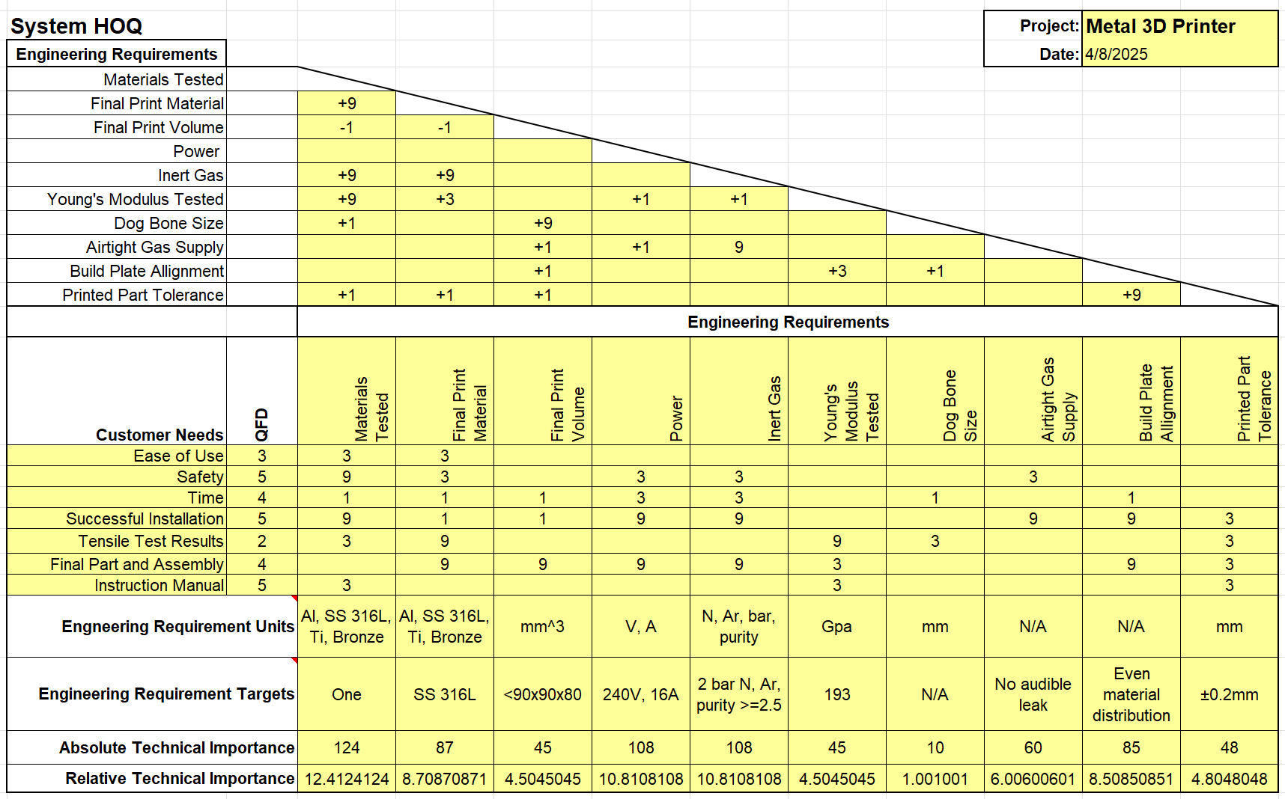
QFD
Notes:
Overview:
Installing and Troubleshooting a M100LabR Concept Laser PBF Printer
Printing and evaluating parts and specimens (ie Stress-Strain, Thermal Management)
Creation of a user manual and short curriculum for ME286L
Included is the printer itself, powder mixer, powder trolley, and various powdered alloys for use with the printer
Location of set-up: CEIAS IDEA Lab, Room 116A

Slide 7
Literature Review
Books:
Papers:
[1] R. C. Hibbeler, Mechanics of Materials. Pearson Higher Ed, 2011.
[5] Hofmann Innovation Group, "Concept Laser Operating Manual, Type: Mlab cusing R", Concept Laster, 2015.
[2] A. T. Sutton, C. S. Kriewall, M. C. Leu, and J. W. Newkirk, “Powder characterisation techniques and effects of powder characteristics on part properties in powder-bed fusion processes,” Virtual and Physical Prototyping, vol. 12, no. 1, pp. 3–29, Dec. 2016, doi: https://doi.org/10.1080/17452759.2016.1250605.
[3] S. Sun, M. Brandt, and M. Easton, “2 - Powder bed fusion processes: An overview,” ScienceDirect, Jan. 01, 2017. https://www.sciencedirect.com/science/article/pii/B9780081004333000026
[4] J. L. Bartlett and X. Li, “An overview of residual stresses in metal powder bed fusion,” Additive Manufacturing, vol. 27, pp. 131–149, May 2019, doi: https://doi.org/10.1016/j.addma.2019.02.020.
Websites:
[7] AddUp, “Surface Finish for 3D Printed Tooling: Advancing PBF Technology as a Production Tool | Blog,” AddUp, Oct. 05, 2023. https://addupsolutions.com/surface-finish-for-3d-printed-tooling-advancing-pbf-technology-as-a-production-tool-blog/
[8] Materion, “Stress-Strain Concepts: Why They Matter in Materials Testing,” Materion.com, Jul. 22, 2024. https://www.materion.com/en/insights/blog/stress-strain-concepts-materials-testing
[9] Materion, “All About Tensile Testing: How to Set Up Your Samples for Accurate Results,” Materion.com, Jun. 17, 2024. https://www.materion.com/en/insights/blog/All-About-Tensile-Testing
Standard:
[6] “Additive manufacturing of metals — Finished part properties — Post-processing, inspection and testing of parts produced by powder bed fusion,” Astm.org, 2014. https://www.astm.org/f3591-23.html
Notes:
Books
[1] R. G. Budynas, J Keith Nisbett, and Joseph Edward Shigley, Shigley’s mechanical engineering design, 11th ed. New York, Ny: Mcgraw-Hill Education, 2020.
[5] Hofmann Innovation Group, "Concept Laser Operating Manual, Type: Mlab cusing R", Concept Laster, 2015.
Papers
[2] A. T. Sutton, C. S. Kriewall, M. C. Leu, and J. W. Newkirk, “Powder characterisation techniques and effects of powder characteristics on part properties in powder-bed fusion processes,” Virtual and Physical Prototyping, vol. 12, no. 1, pp. 3–29, Dec. 2016, doi: https://doi.org/10.1080/17452759.2016.1250605.
[3] S. Sun, M. Brandt, and M. Easton, “2 - Powder bed fusion processes: An overview,” ScienceDirect, Jan. 01, 2017. https://www.sciencedirect.com/science/article/pii/B9780081004333000026
[4] J. L. Bartlett and X. Li, “An overview of residual stresses in metal powder bed fusion,” Additive Manufacturing, vol. 27, pp. 131–149, May 2019, doi: https://doi.org/10.1016/j.addma.2019.02.020.
Standard
[6] “Additive manufacturing of metals — Finished part properties — Post-processing, inspection and testing of parts produced by powder bed fusion,” Astm.org, 2014. https://www.astm.org/f3591-23.html

Slide 8
Literature Review
Books:
Papers:
[1] P. Konda Gokuldoss, Selective Laser Melting: Materials and Applications. MDPI AG, 2020.
[2] N. H. Kim, A. V. Kumar, and B. V. Sankar, Introduction to finite element analysis and design, Second edition. Hoboken, New Jersey: John Wiley & Sons, 2018.
[3] “Research of 316L Metallic Powder for Use in SLM 3D Printing,” Advances in Materials Science/Advances in Materials Sciences, 2020, doi: 10.2478/adms-2020-0001.
[4] D. Gogolewski, T. Bartkowiak, T. Kozior, and P. Zmarzły, “Multiscale Analysis of Surface Texture Quality of Models Manufactured by Laser Powder-Bed Fusion Technology and Machining from 316L Steel,” Materials, vol. 14, no. 11, pp. 2794-, 2021, doi: 10.3390/ma14112794.
[5] W. Zhang, J. Zhu, and T. Gao, Topology optimization in engineering structure design. London, [England] ; ISTE Press, 2016.
Websites:
[7] “Topology Optimization 101: How to Use Algorithmic Models to Create Lightweight Design,” Formlabs. https://formlabs.com/blog/topology-optimization/
[8] Loughborough University, “Powder Bed Fusion | Additive Manufacturing Research Group | Loughborough University,” Lboro.ac.uk, 2010. https://www.lboro.ac.uk/research/amrg/about/the7categoriesofadditivemanufacturing/powderbedfusion/
[2] “Metal 3D Printer Precision System | Objective 3D,” Objective3D, Feb. 18, 2024. https://www.objective3d.com.au/product/concept-laser-mlabs/ (accessed Sep. 18, 2024).
Standard:
[6] F3184 Standard Specification for Additive Manufacturing Stainless Steel Alloy (UNS S31603) with Powder Bed Fusion. 2023. doi: 10.1520/F3184-16R23.

Slide 9
Commissioning Process
1. Needs Assessment
Requirements
Consultation with Stakeholders
Equipment: Wet-separating vacuum, argon tank holder, PPE, wire EDM/bandsaw, etc.
Software: Magics, Autodesk Netfabb
Lab: 240V outlet, chemical disposal
Mike Downey: Industry expert and donation involvement.
Dr. Constantin Ciocanel: ME Department Chair and project sponsor
Honeywell and U of A: Industry standards and successful installation
Request for Proposals
Evaluate Proposals
Quotes for equipment
Compare quotes
Contact Finalization
Order equipment and submit work orders
3. Pre-Installation Planning
Site Preparation
Infrastructure Checks
Meet with EHS chemical safety representative in IDEA Lab: ventilation, safety procedures, machine and gas placement, etc.
Install 240V outlet
Ensure safe disposal area
2. Vendor Selection and Procurement
Vendor Research
Equipment
Electrician
GE health check and upgrade
Notes:
Overview:
Installing and Troubleshooting a M100LabR Concept Laser PBF Printer
Printing and evaluating parts and specimens (ie Stress-Strain, Thermal Management)
Creation of a user manual and short curriculum for ME286L
Included is the printer itself, powder mixer, powder trolley, and various powdered alloys for use with the printer
Location of set-up: CEIAS IDEA Lab, Room 116A

Slide 10
Commissioning Process Cont.
4. Installation and Setup
Installation
Software Setup
Manual installation guide
Install Autodesk Netfabb on new computer
Ensure existing machine software is operational
Troubleshooting
Machine Repair
Find alignment issues and determine cause
Determine if external technician needed for repair
Fix issue
5. Testing
Without material, then with material
Initial Calibration and Configuration
Built in software configuration and machine calibration
Safety Testing
Test emergency stops, ventilation, etc.
Functional Testing
Starting with small prints
6. Training
User Training
Maintenance Training
First print tutorial with model and full instruction manual: How to slice a model in Magics, upload and use printer software, and run printer.
IDEA Lab employee will need to maintain printer
Notes:
Overview:
Installing and Troubleshooting a M100LabR Concept Laser PBF Printer
Printing and evaluating parts and specimens (ie Stress-Strain, Thermal Management)
Creation of a user manual and short curriculum for ME286L
Included is the printer itself, powder mixer, powder trolley, and various powdered alloys for use with the printer
Location of set-up: CEIAS IDEA Lab, Room 116A

Slide 11
Commissioning Process Cont.
7. Ongoing Maintenance and Support
Regular Maintenance
Maintenance schedule and instructions
Vendor Support
Maintain GE contact for repairs and support
Successful Commissioning:
Fixed and fully operational
Safe
Ready for IDEA Lab training and student work orders
Ready for implementation into ME 286L curriculum
8. Documentation and Handover
Documentation
Ensure manuals and safety documentation are available and easily accessible
Notes:
Overview:
Installing and Troubleshooting a M100LabR Concept Laser PBF Printer
Printing and evaluating parts and specimens (ie Stress-Strain, Thermal Management)
Creation of a user manual and short curriculum for ME286L
Included is the printer itself, powder mixer, powder trolley, and various powdered alloys for use with the printer
Location of set-up: CEIAS IDEA Lab, Room 116A

Slide 12
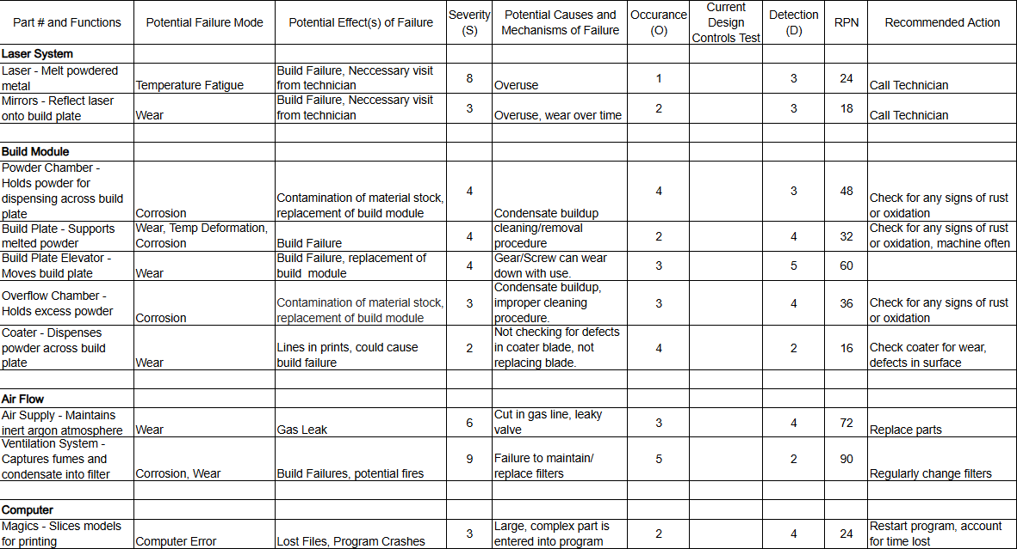
FMEA - Printer
Critical potential failures/ how to mitigate
Build Plate
Build Plate Elevator
Coater
Ventilation System
Testing Procedures
Regular maintenance
Inspect module for damage or corrosion
Testing Resources
User manual
Excel Charts
Calendar
Table 1: Printer FMEA
Notes:
Overview:
Installing and Troubleshooting a M100LabR Concept Laser PBF Printer
Printing and evaluating parts and specimens (ie Stress-Strain, Thermal Management)
Creation of a user manual and short curriculum for ME286L
Included is the printer itself, powder mixer, powder trolley, and various powdered alloys for use with the printer
Location of set-up: CEIAS IDEA Lab, Room 116A

Slide 13
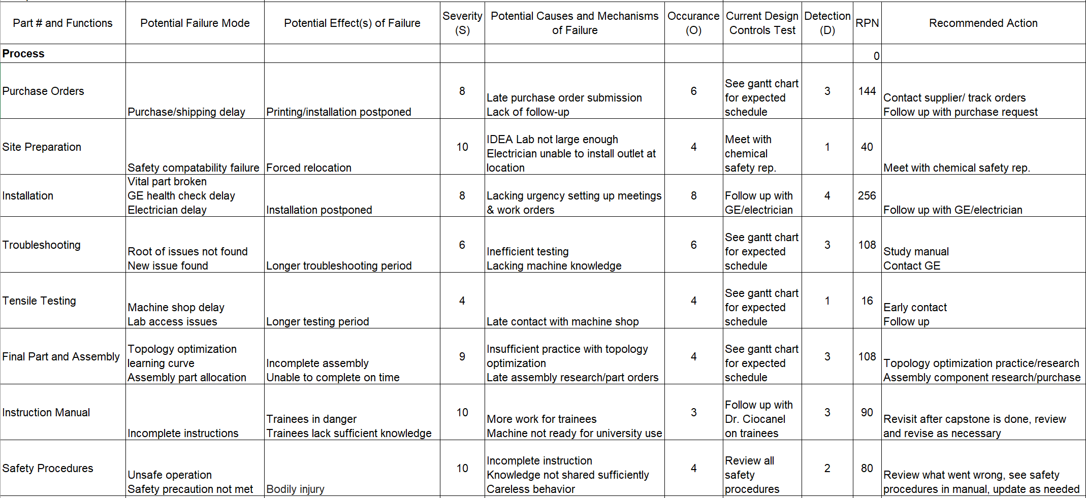
FMEA - Process
Critical Potential Failures
Purchase orders
Installation
Troubleshooting
Final part and assembly
Testing procedures
Stay in contact with outside resources
Stay ahead of learning curve
Frequently update and review Gantt chart
Testing Resources
Gmail
Excel
SolidWorks
Udemy
Table 2: Process FMEA
Notes:
Overview:
Installing and Troubleshooting a M100LabR Concept Laser PBF Printer
Printing and evaluating parts and specimens (ie Stress-Strain, Thermal Management)
Creation of a user manual and short curriculum for ME286L
Included is the printer itself, powder mixer, powder trolley, and various powdered alloys for use with the printer
Location of set-up: CEIAS IDEA Lab, Room 116A

Slide 14
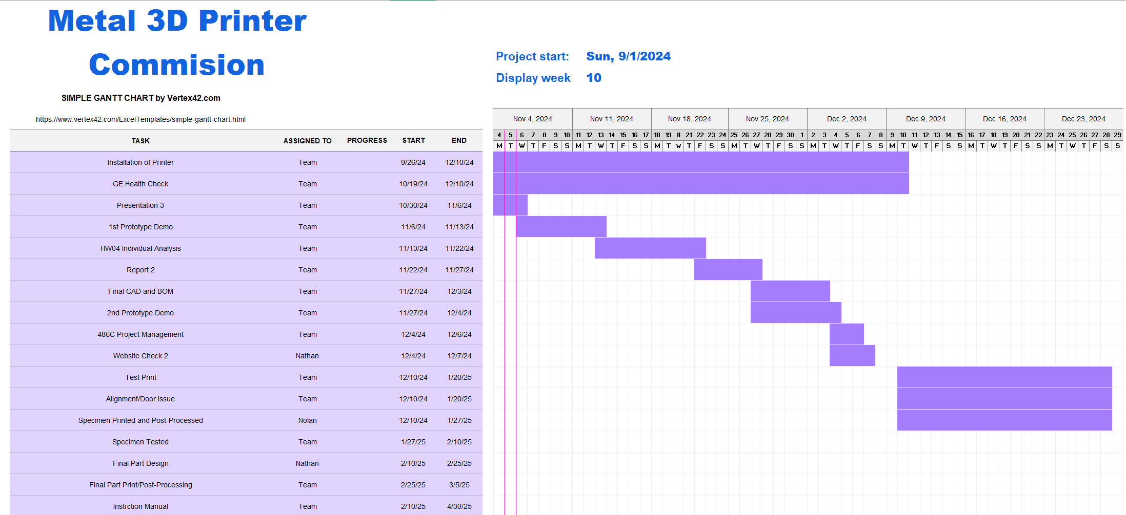
Schedule, Semester 1

Slide 15
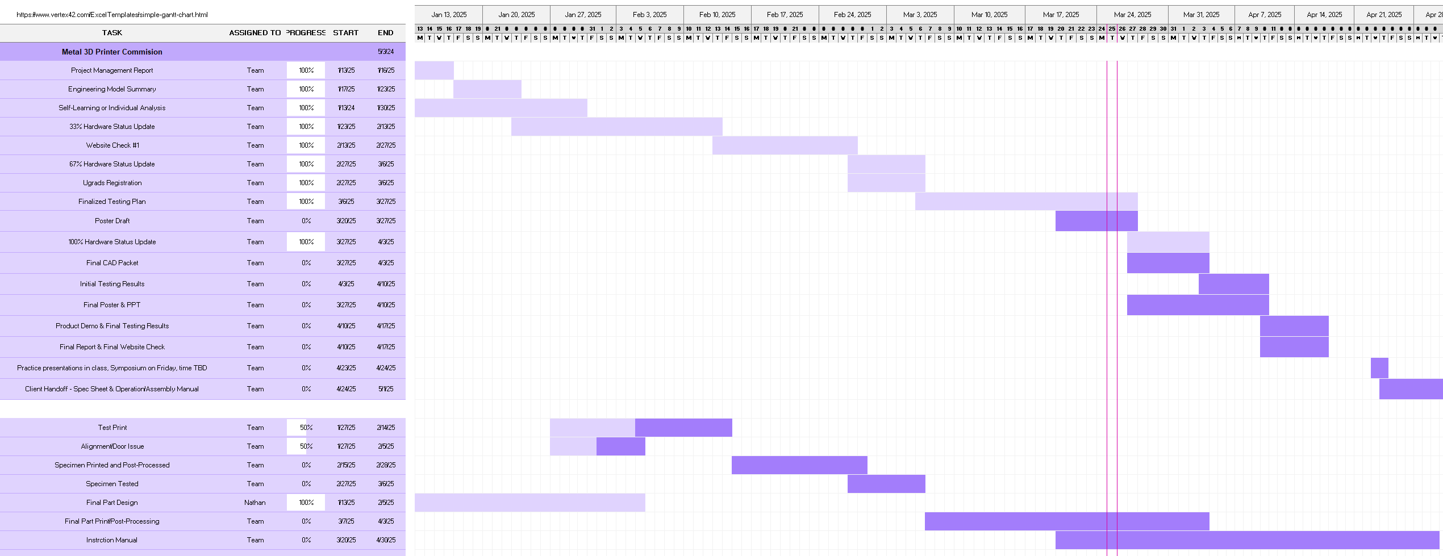
Schedule, Semester 2
Notes:
Overview:
Installing and Troubleshooting a M100LabR Concept Laser PBF Printer
Printing and evaluating parts and specimens (ie Stress-Strain, Thermal Management)
Creation of a user manual and short curriculum for ME286L
Included is the printer itself, powder mixer, powder trolley, and various powdered alloys for use with the printer
Location of set-up: CEIAS IDEA Lab, Room 116A

Slide 16
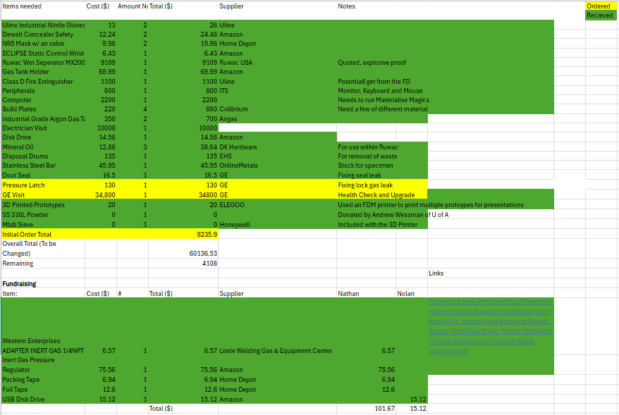
Budget and Bill of Materials
Notes:
Overview:
Installing and Troubleshooting a M100LabR Concept Laser PBF Printer
Printing and evaluating parts and specimens (ie Stress-Strain, Thermal Management)
Creation of a user manual and short curriculum for ME286L
Included is the printer itself, powder mixer, powder trolley, and various powdered alloys for use with the printer
Location of set-up: CEIAS IDEA Lab, Room 116A

Slide 17
Design Evaluation and Simulation
Section 2:

Slide 18
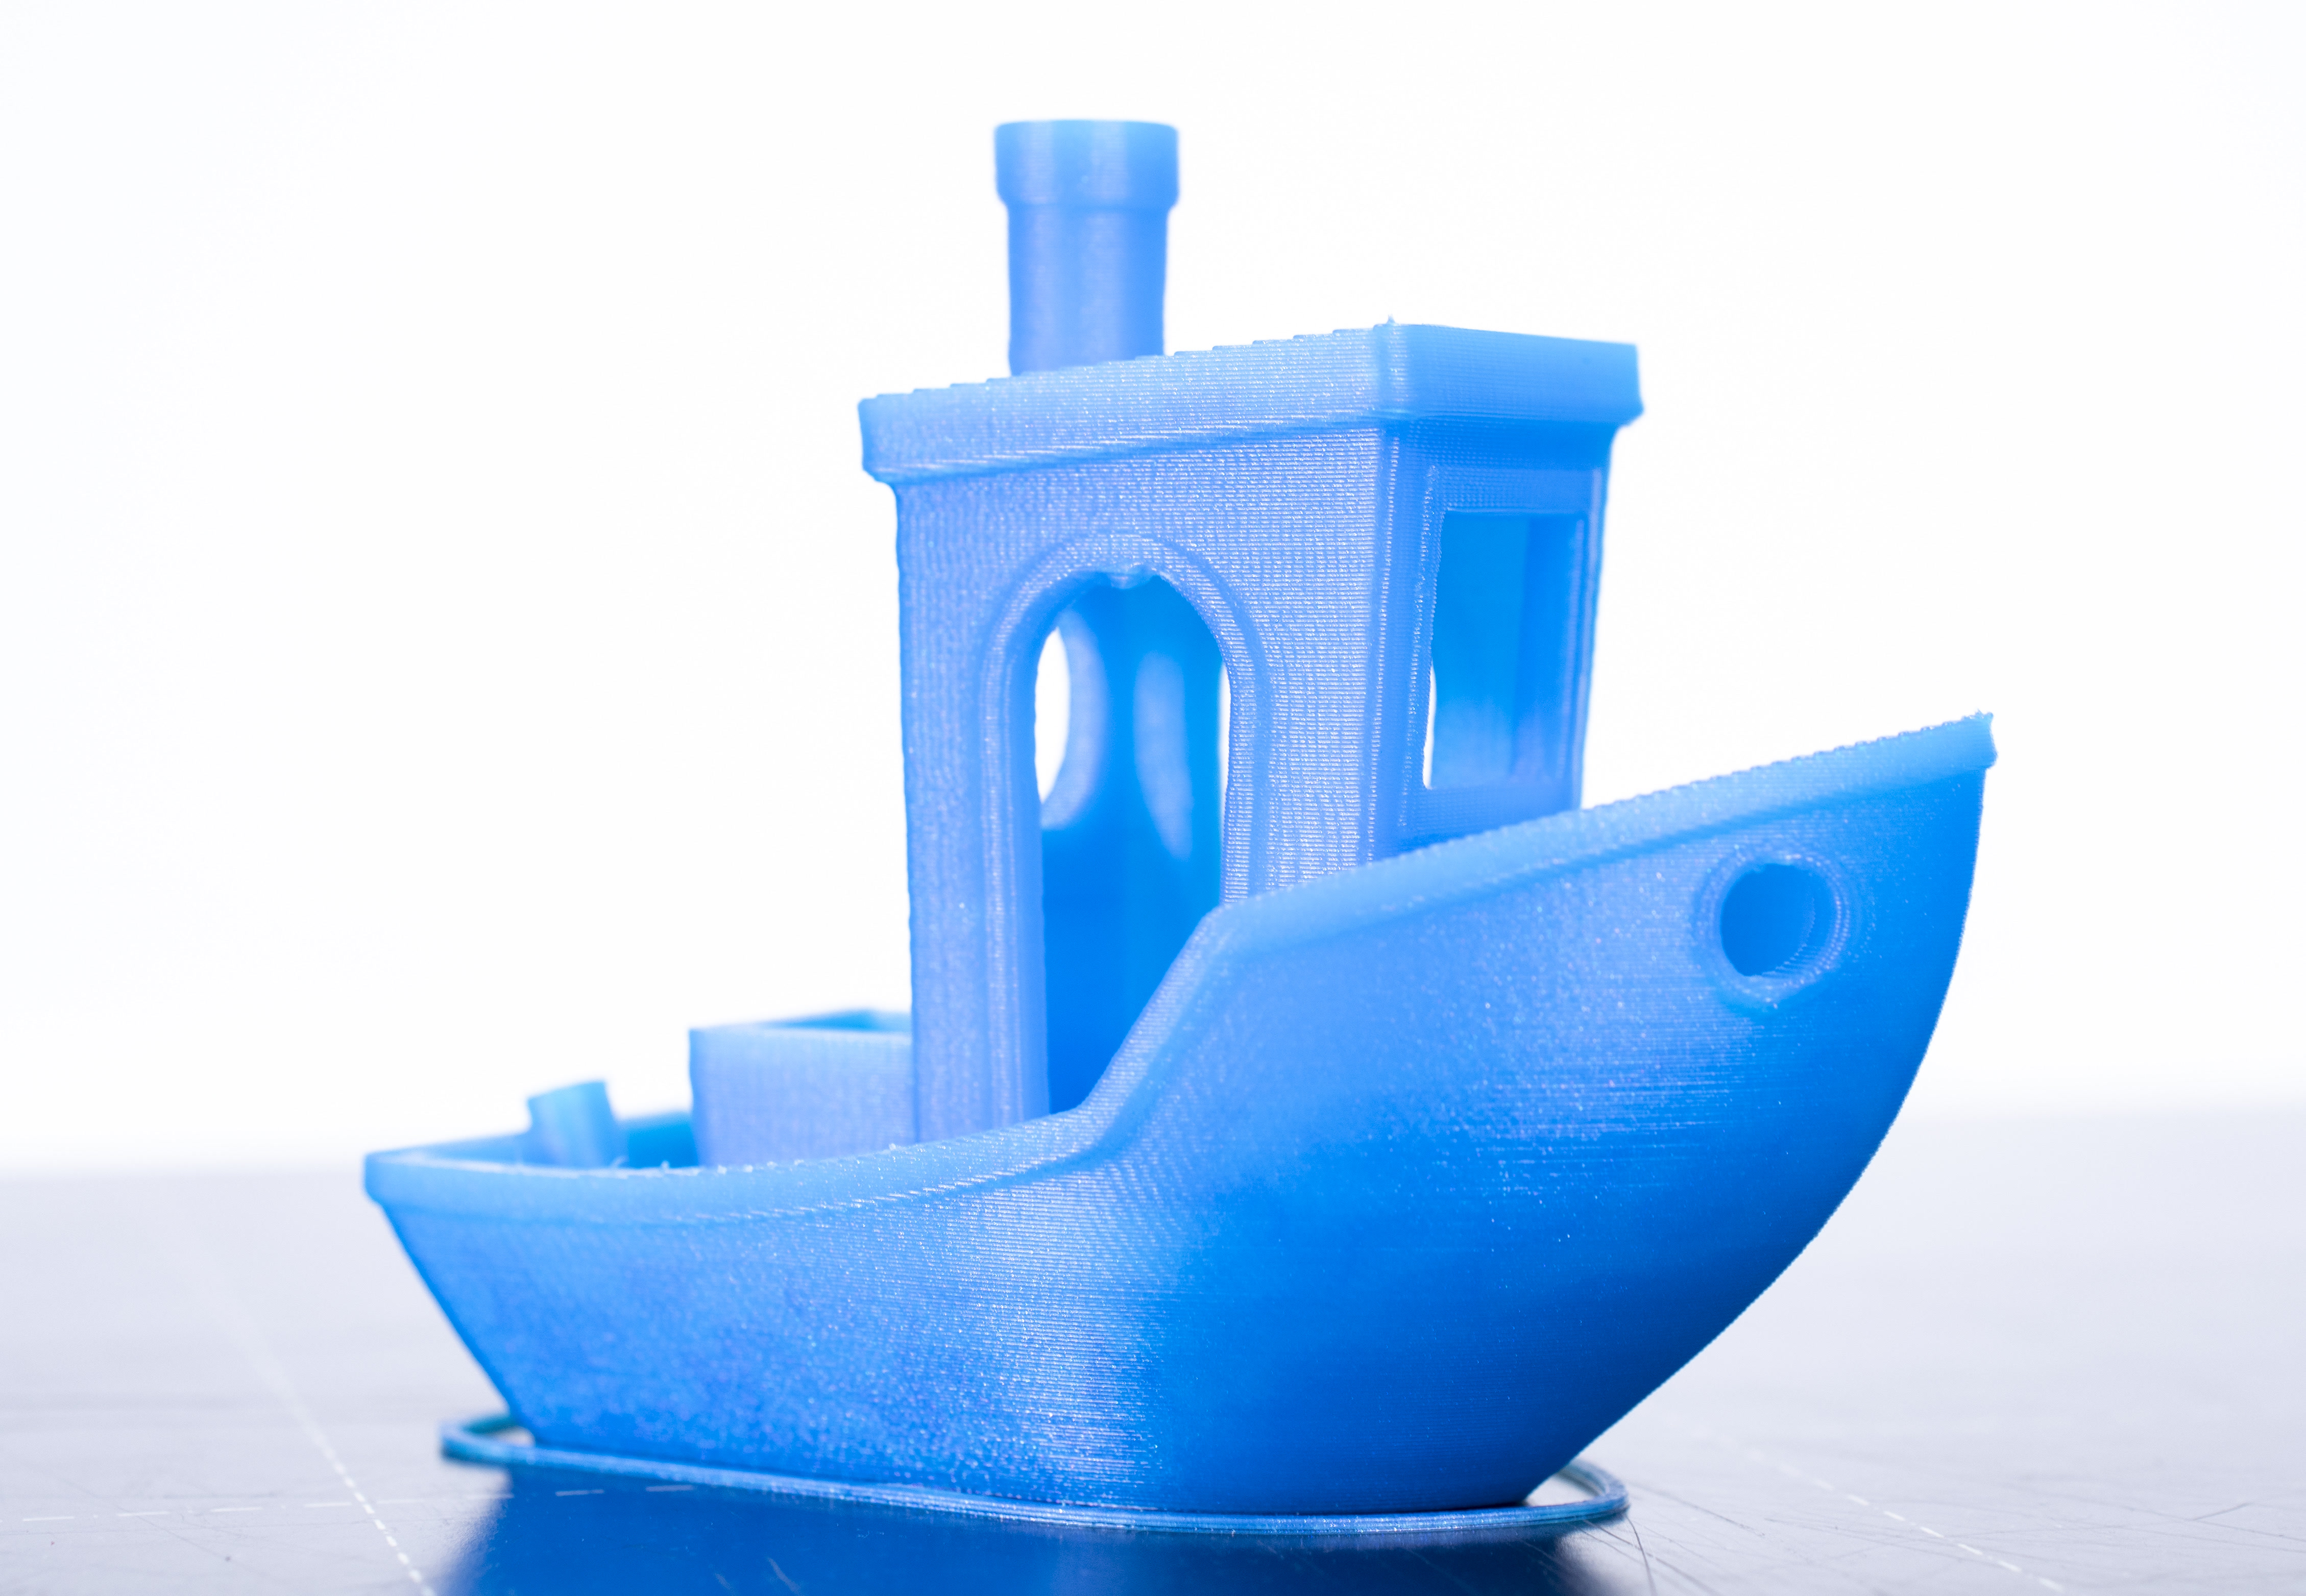
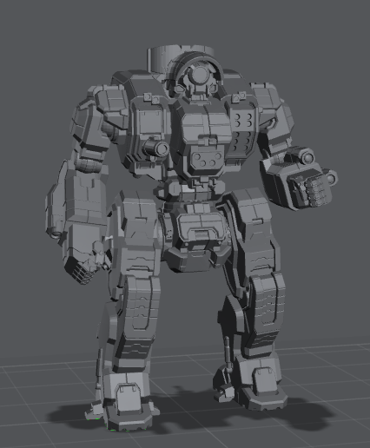
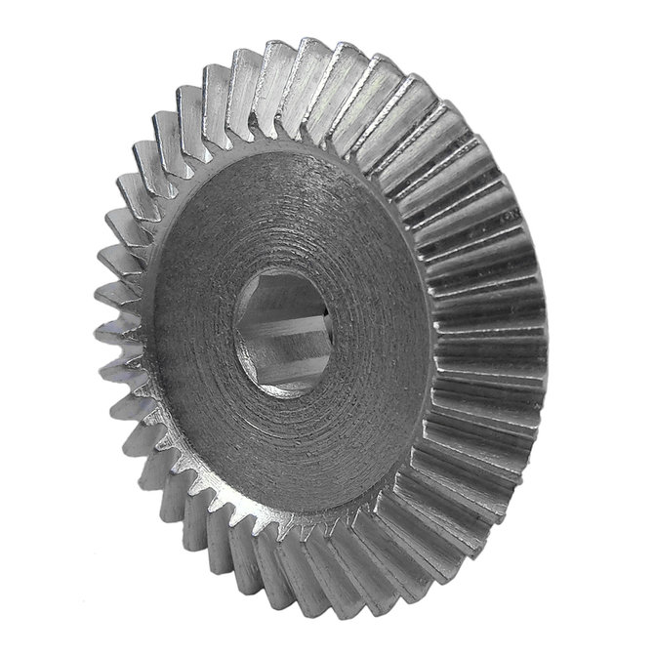
Concept Gen. - Test Print
Benchy
Miniature
Gear
Pros | Cons
Ubiquitous | Size
Easy to spot layer defects | Can be printed on most machines
Engineered for test printing | Heavy overhangs
Pros | Cons
Complex part | Likely failure
Good demonstration machine capability | Potential waste of powder
Pros | Cons
Complex part | Non-additive manufacturing
Tolerance testing | Assembly dependent
Notes:
Overview:
Installing and Troubleshooting a M100LabR Concept Laser PBF Printer
Printing and evaluating parts and specimens (ie Stress-Strain, Thermal Management)
Creation of a user manual and short curriculum for ME286L
Included is the printer itself, powder mixer, powder trolley, and various powdered alloys for use with the printer
Location of set-up: CEIAS IDEA Lab, Room 116A

Slide 19
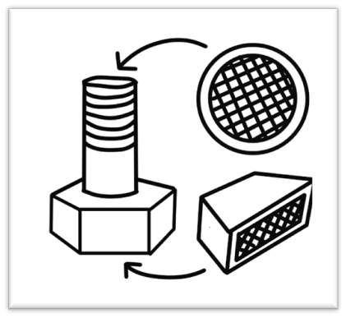
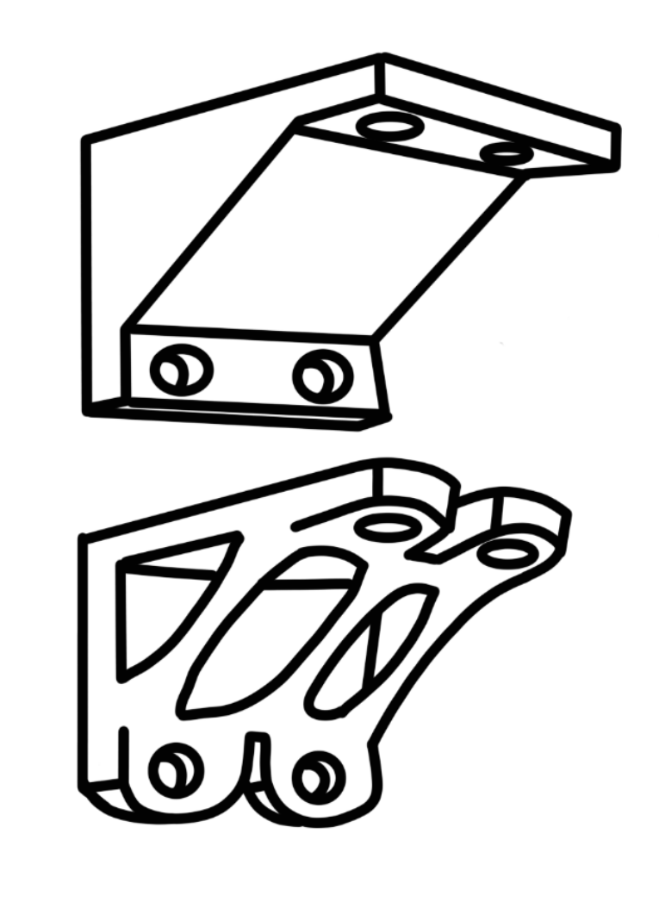
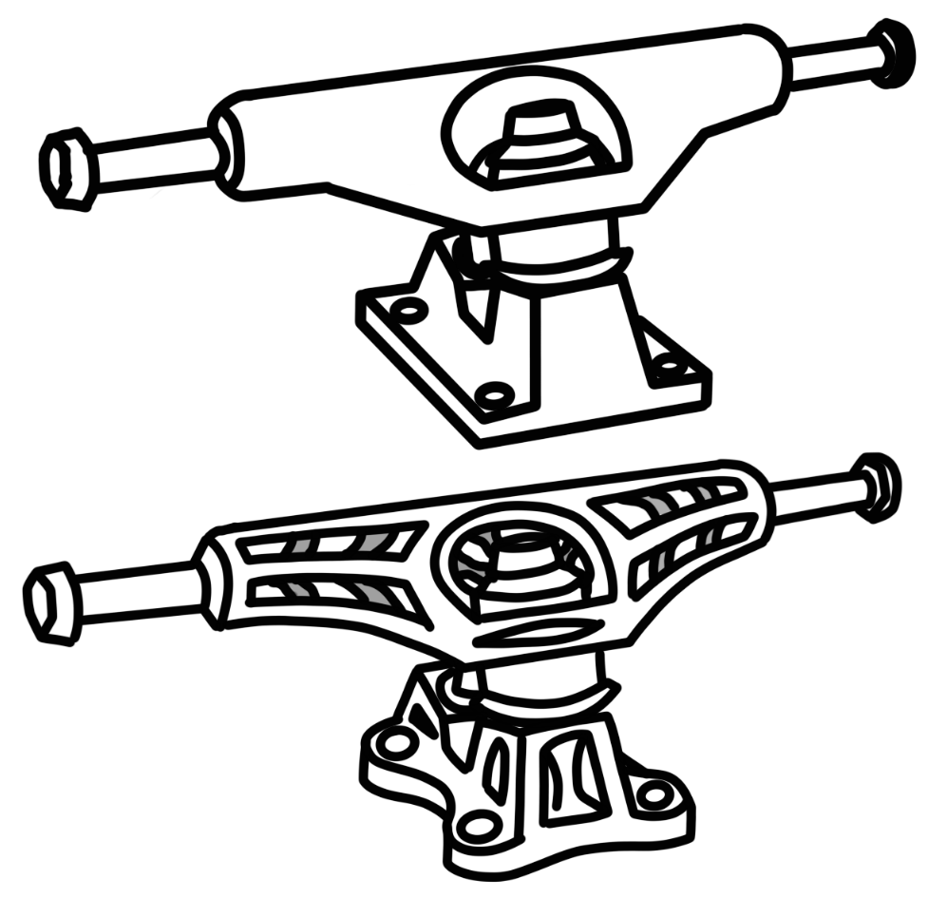
Concept Gen. - Final Part
Fastener
Bracket
Skateboard Truck
Pros | Cons
Simple assembly | Low tolerance
New to industry | Not visually impactful
Useful at scale | Only lattice
Pros | Cons
Simple assembly | Industry standard
High tolerance | Only topology optimization
Useful at scale | More useful at larger scales
Pros | Cons
Topology and lattice viable | More useful at larger scales
Visually impactful | Involved assembly
New to industry | Complicated geometry
Notes:
Overview:
Installing and Troubleshooting a M100LabR Concept Laser PBF Printer
Printing and evaluating parts and specimens (ie Stress-Strain, Thermal Management)
Creation of a user manual and short curriculum for ME286L
Included is the printer itself, powder mixer, powder trolley, and various powdered alloys for use with the printer
Location of set-up: CEIAS IDEA Lab, Room 116A

Slide 20
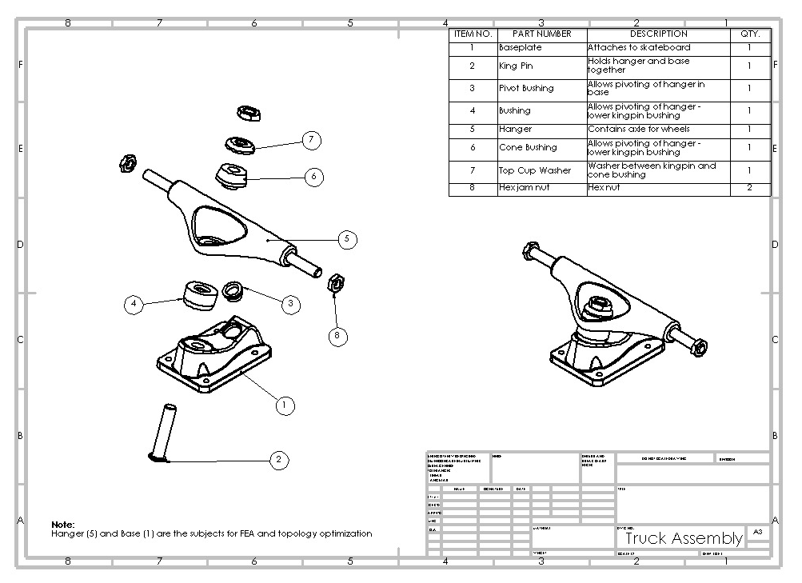
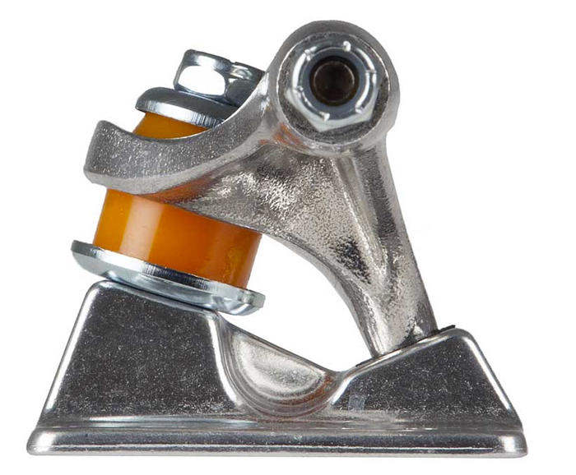
Design Description
Function:
Hanger pivots from side to side
  Kingpin bushings and pivot socket
Allows for controlled turning by putting pressure on those bushings
Pivot axis is tilted to allow for both horizontal and vertical rotation
Pivot Axis
Figure 7: Truck Assembly Drawing
Figure 12: Truck pivot axis
Notes:
Overview:
Installing and Troubleshooting a M100LabR Concept Laser PBF Printer
Printing and evaluating parts and specimens (ie Stress-Strain, Thermal Management)
Creation of a user manual and short curriculum for ME286L
Included is the printer itself, powder mixer, powder trolley, and various powdered alloys for use with the printer
Location of set-up: CEIAS IDEA Lab, Room 116A

Slide 21
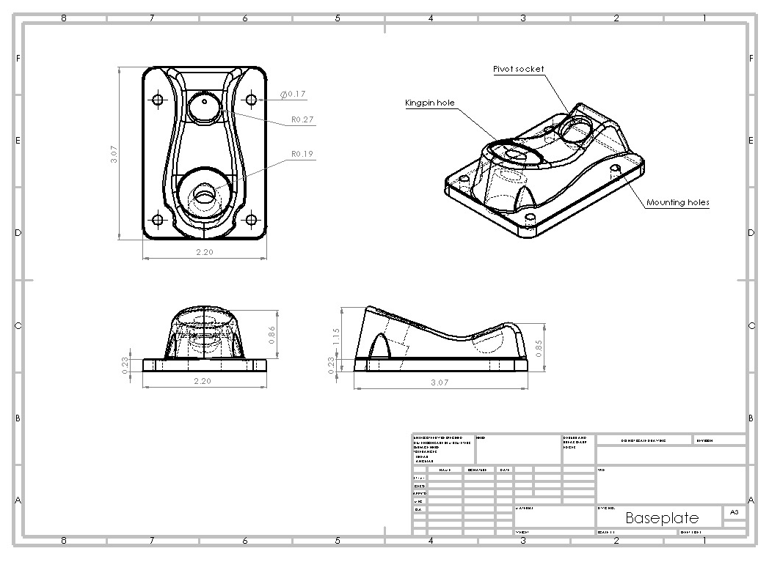
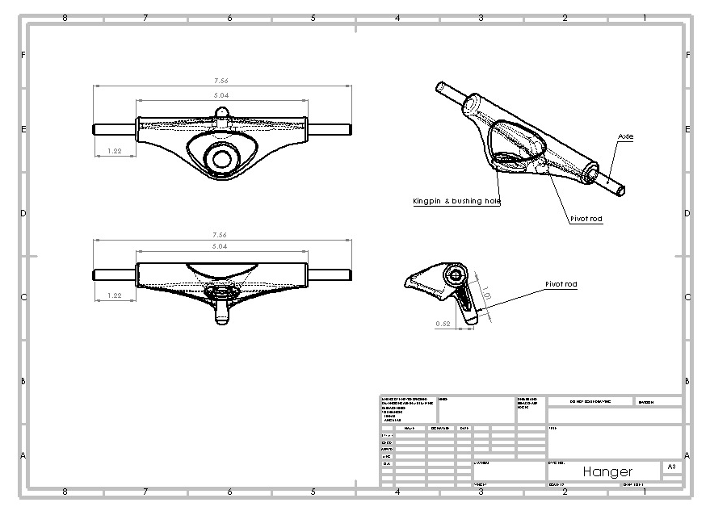
Design Description
Figure 8: Baseplate Drawing
Figure 9: Hanger Drawing
Notes:
Overview:
Installing and Troubleshooting a M100LabR Concept Laser PBF Printer
Printing and evaluating parts and specimens (ie Stress-Strain, Thermal Management)
Creation of a user manual and short curriculum for ME286L
Included is the printer itself, powder mixer, powder trolley, and various powdered alloys for use with the printer
Location of set-up: CEIAS IDEA Lab, Room 116A

Slide 22
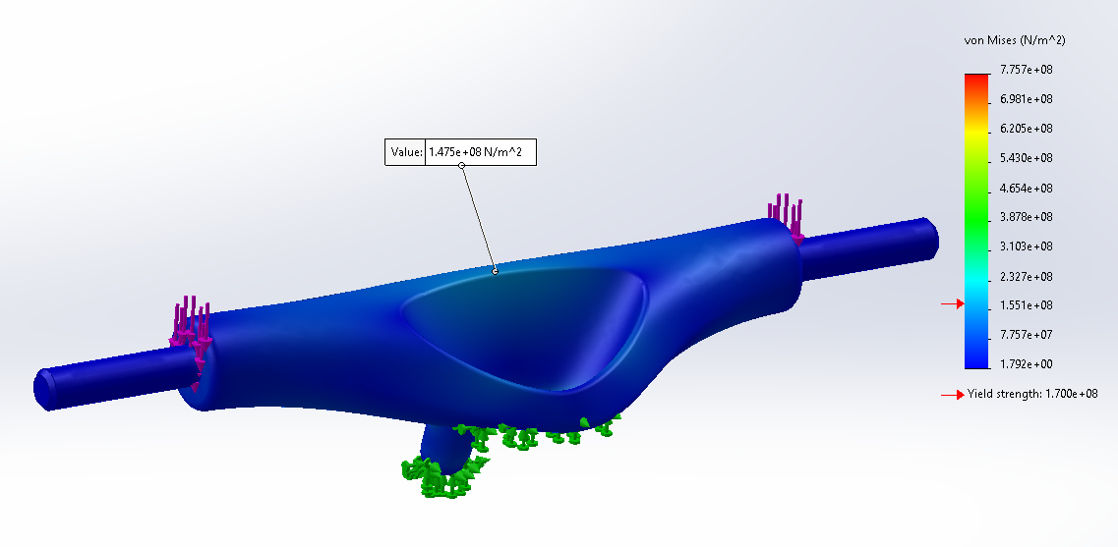
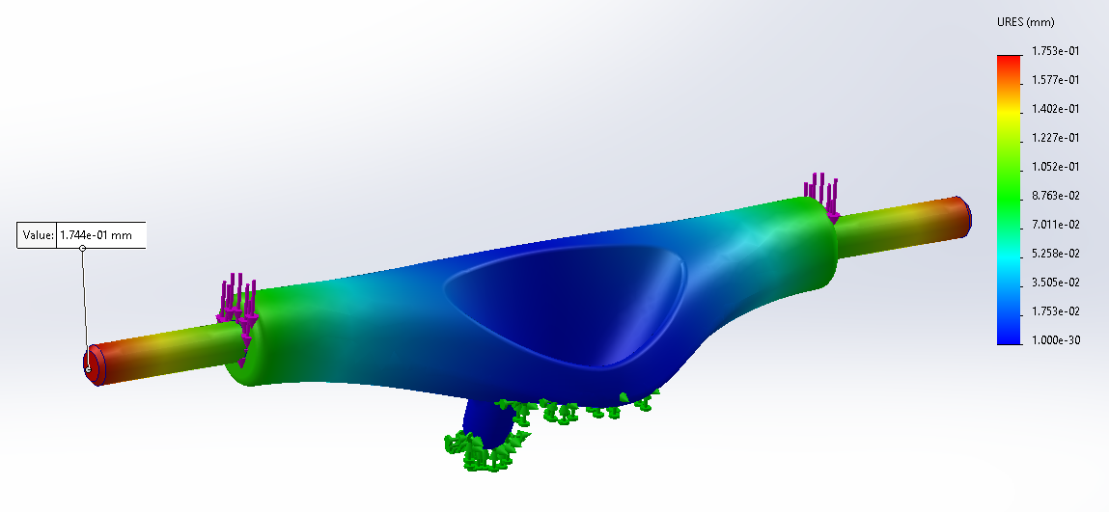
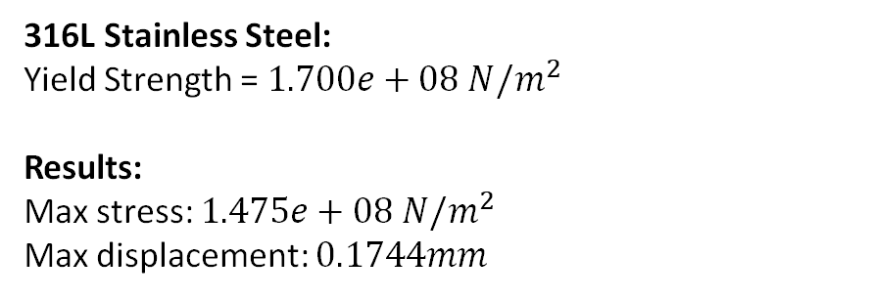
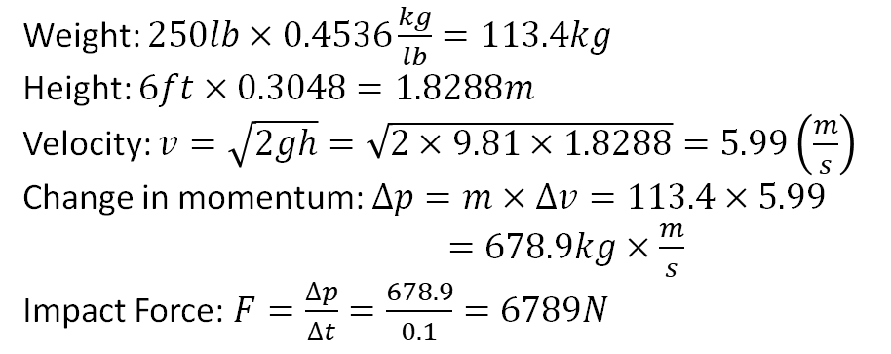
Eng. Calculations
Load Case: 250lb person falling 6ft onto one truck
Weight: $250lb×0.4536\frac{kg}{lb}=113.4kg$
Height: $6ft×0.3048=1.8288m$
Velocity: $v=\sqrt{2gh}=\sqrt{2×9.81×1.8288}=5.99\left(\frac{m}{s}\right)$
Change in momentum: $∆p=m×∆v=113.4×5.99$
$=678.9kg×\frac{m}{s}$
Impact Force: $F=\frac{∆p}{∆t}=\frac{678.9}{0.1}=6789N$
Figure 10: Truck Hangar FEA: Stress
316L Stainless Steel:
Yield Strength = $1.700e+08 N/m^{2}$
Results:
Max stress: $1.475e+08 N/m^{2}$
Max displacement: $0.1744mm$
Figure 11: Truck Hangar FEA: Displacement
Notes:
Overview:
Installing and Troubleshooting a M100LabR Concept Laser PBF Printer
Printing and evaluating parts and specimens (ie Stress-Strain, Thermal Management)
Creation of a user manual and short curriculum for ME286L
Included is the printer itself, powder mixer, powder trolley, and various powdered alloys for use with the printer
Location of set-up: CEIAS IDEA Lab, Room 116A

Slide 23
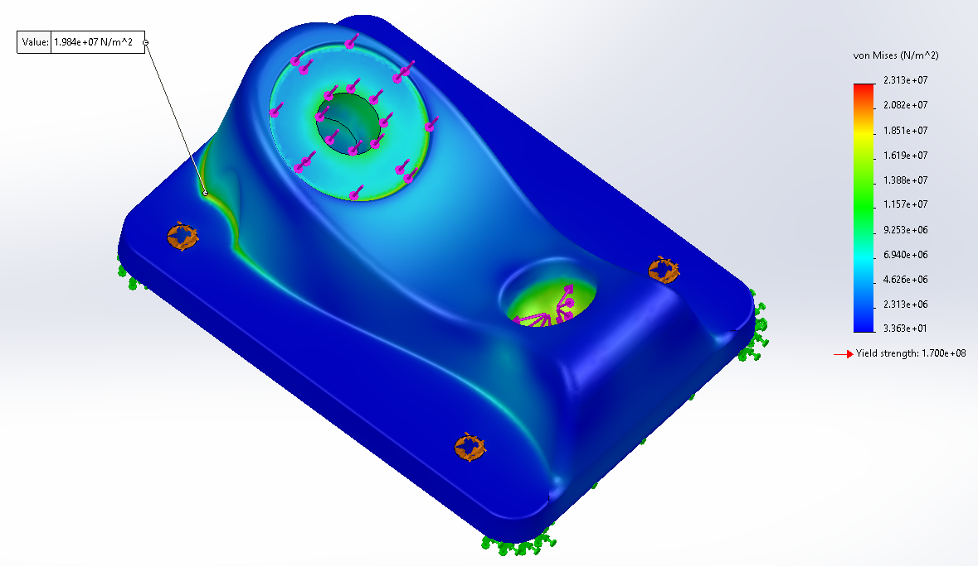
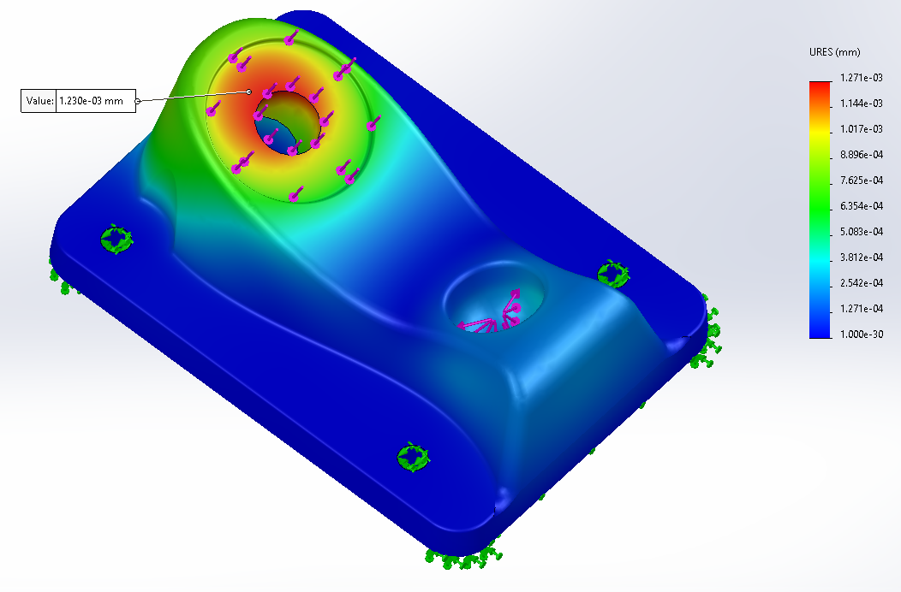
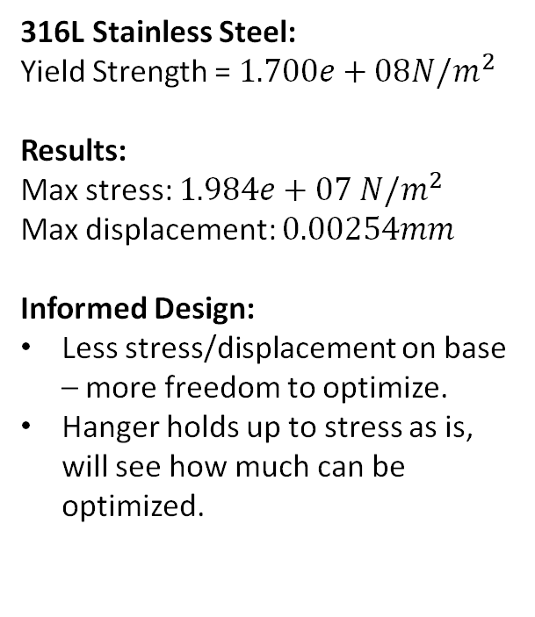
Eng. Calculations
Load Case: 250lb person falling 6ft onto one truck
316L Stainless Steel:
Yield Strength = $1.700e+08N/m^{2}$
Results:
Max stress: $1.984e+07 N/m^{2}$
Max displacement: $0.00254mm$
Informed Design:
Less stress/displacement on base – more freedom to optimize.
Hanger holds up to stress as is, will see how much can be optimized.
Figure 12: Truck Base FEA: Stress
Figure 13: Truck Base FEA: Displacement
Notes:
Overview:
Installing and Troubleshooting a M100LabR Concept Laser PBF Printer
Printing and evaluating parts and specimens (ie Stress-Strain, Thermal Management)
Creation of a user manual and short curriculum for ME286L
Included is the printer itself, powder mixer, powder trolley, and various powdered alloys for use with the printer
Location of set-up: CEIAS IDEA Lab, Room 116A

Slide 24
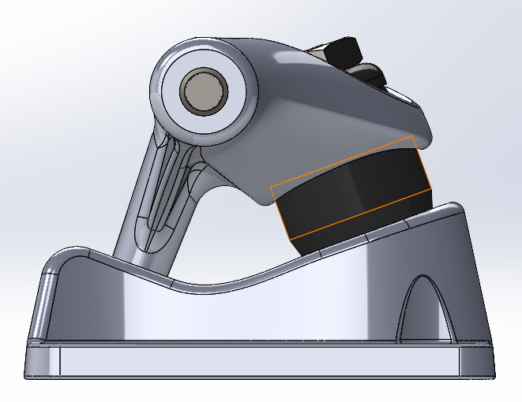
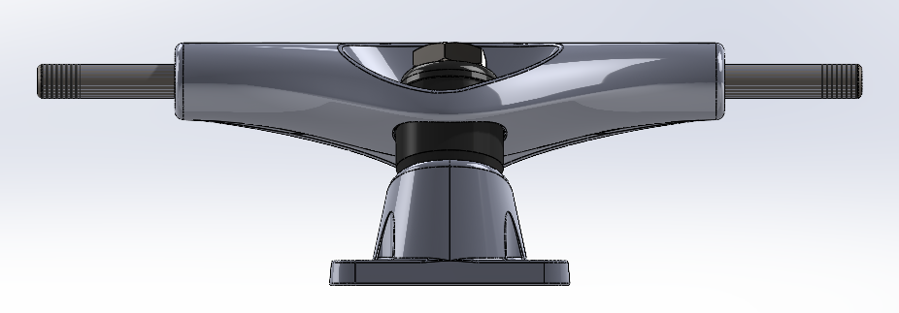
Load Conditions
Load Situations:
All the following load conditions are applied at the same time for the FEA and topology optimization.
Figure 14: Load Case – Truck Grinding
Figure 15: Load Case – Vertical Impact
Figure 16: Load Case – Horizontal Impact
Grinding on truck:
Distributed load along the top of the truck.
Calculated as an impact force of a 250lb person and 5.5lb skateboard falling 3ft onto one truck with an impact time of 0.1 seconds
4927N distributed along surface.
Meant to account for the initial impact of the truck landing on a rail or ledge, not accounting for horizontal momentum.
Landing on truck:
Vertical point loads at both ends of the truck.
Calculated as an impact force of a 250lb person and 5.5lb skateboard falling 5ft onto one truck with an impact time of 0.1 seconds
6345N split between each end.
Meant to account for the impact of a person landing on one truck, not accounting for horizontal momentum
Running into an obstacle:
Horizontal point loads at both ends of the truck.
Calculated as an impact force of a 250lb person and 5.5lb skateboard hitting an obstacle at 10mph with an impact time of 0.1 seconds
5186N applied to each end separately.
Meant to account for the impact of a person running into a rock or curb with one wheel.
Notes:
Overview:
Installing and Troubleshooting a M100LabR Concept Laser PBF Printer
Printing and evaluating parts and specimens (ie Stress-Strain, Thermal Management)
Creation of a user manual and short curriculum for ME286L
Included is the printer itself, powder mixer, powder trolley, and various powdered alloys for use with the printer
Location of set-up: CEIAS IDEA Lab, Room 116A

Slide 25
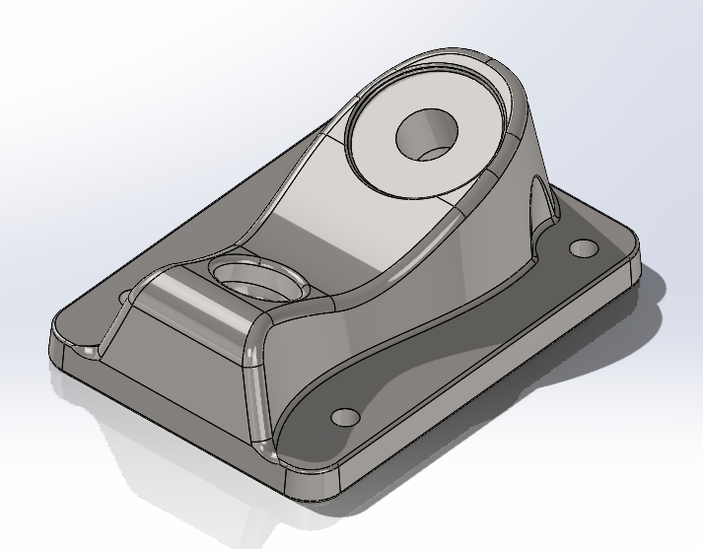
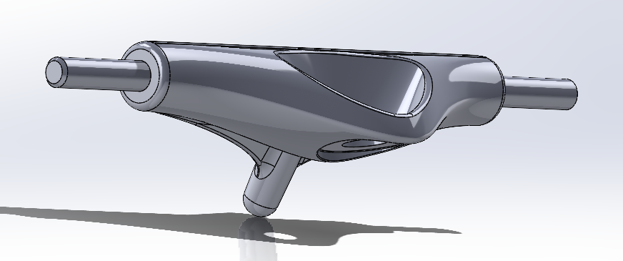
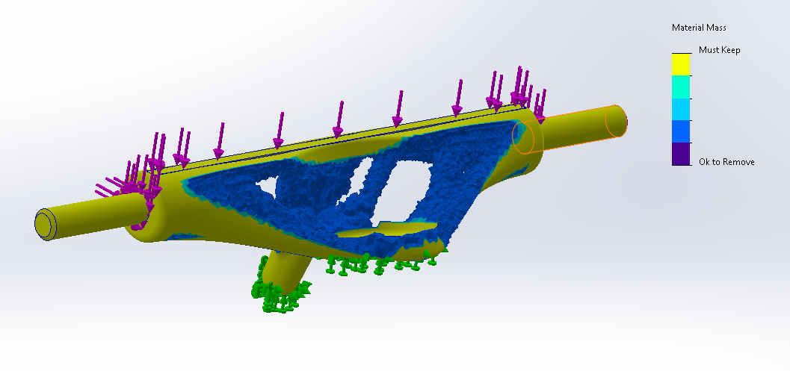
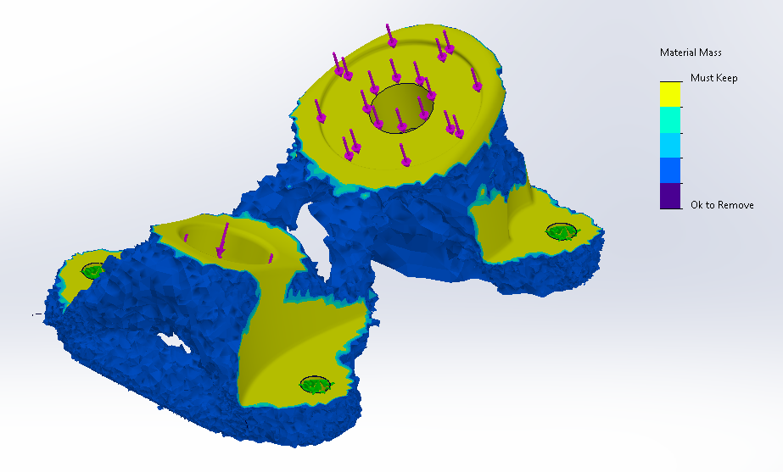
Initial Optimization
Figure 17: Original Hanger
Figure 18: Original Base Plate
Figure 19: Hanger Optimization Results (60%)
Figure 20: Base Plate Optimization Results (60%)
Notes:
Overview:
Installing and Troubleshooting a M100LabR Concept Laser PBF Printer
Printing and evaluating parts and specimens (ie Stress-Strain, Thermal Management)
Creation of a user manual and short curriculum for ME286L
Included is the printer itself, powder mixer, powder trolley, and various powdered alloys for use with the printer
Location of set-up: CEIAS IDEA Lab, Room 116A

Slide 26
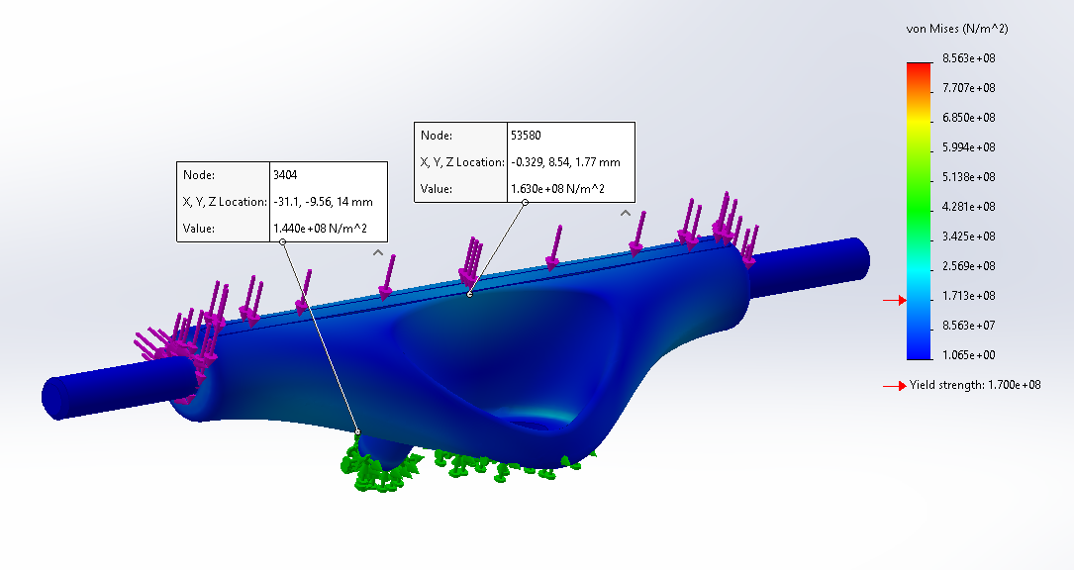
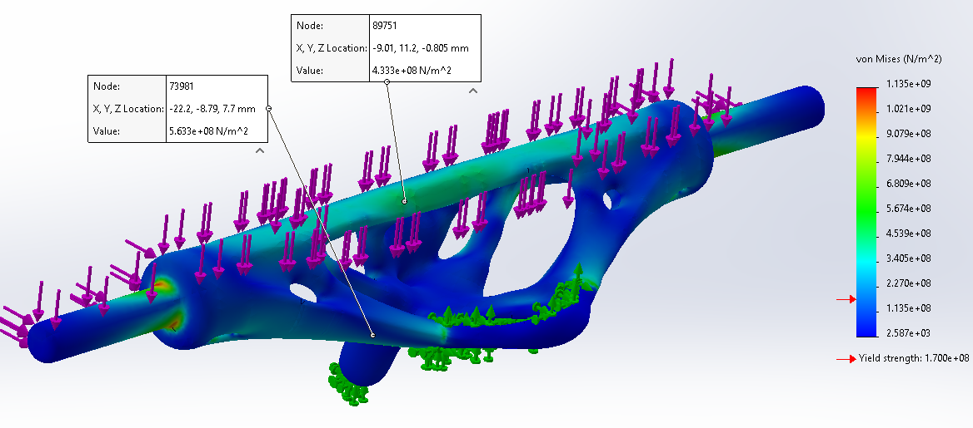
60% Optimization FEA
Figure 21: Original Hanger FEA
Figure 22: Optimized Hanger FEA (60%)
Notes:
Overview:
Installing and Troubleshooting a M100LabR Concept Laser PBF Printer
Printing and evaluating parts and specimens (ie Stress-Strain, Thermal Management)
Creation of a user manual and short curriculum for ME286L
Included is the printer itself, powder mixer, powder trolley, and various powdered alloys for use with the printer
Location of set-up: CEIAS IDEA Lab, Room 116A

Slide 27
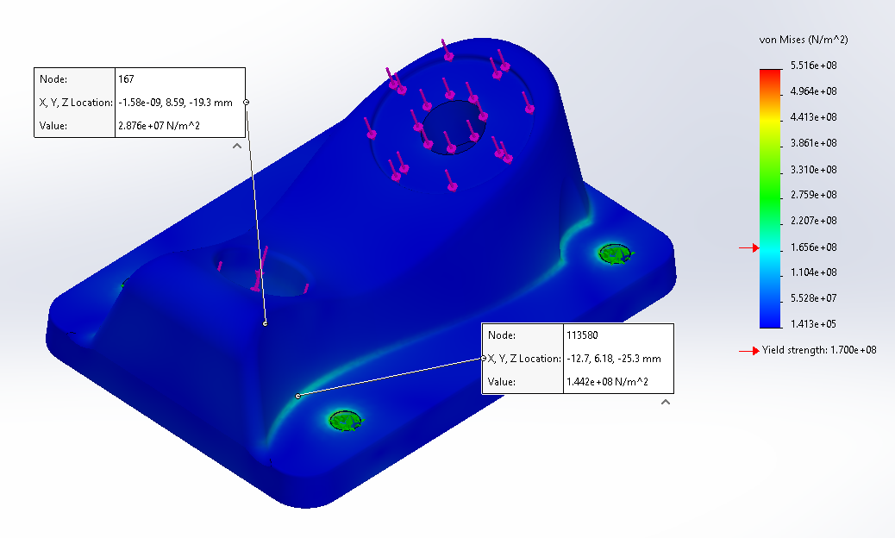
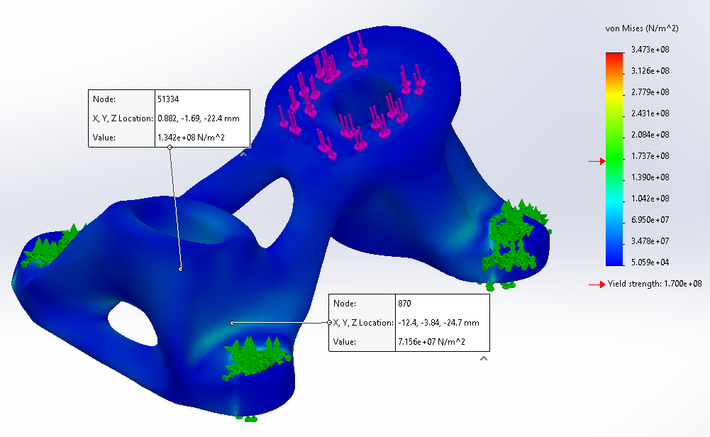
60% Optimization FEA
Figure 23: Original Base Plate FEA
Figure 24: Optimized Base Plate FEA (60%)
Notes:
Overview:
Installing and Troubleshooting a M100LabR Concept Laser PBF Printer
Printing and evaluating parts and specimens (ie Stress-Strain, Thermal Management)
Creation of a user manual and short curriculum for ME286L
Included is the printer itself, powder mixer, powder trolley, and various powdered alloys for use with the printer
Location of set-up: CEIAS IDEA Lab, Room 116A

Slide 28
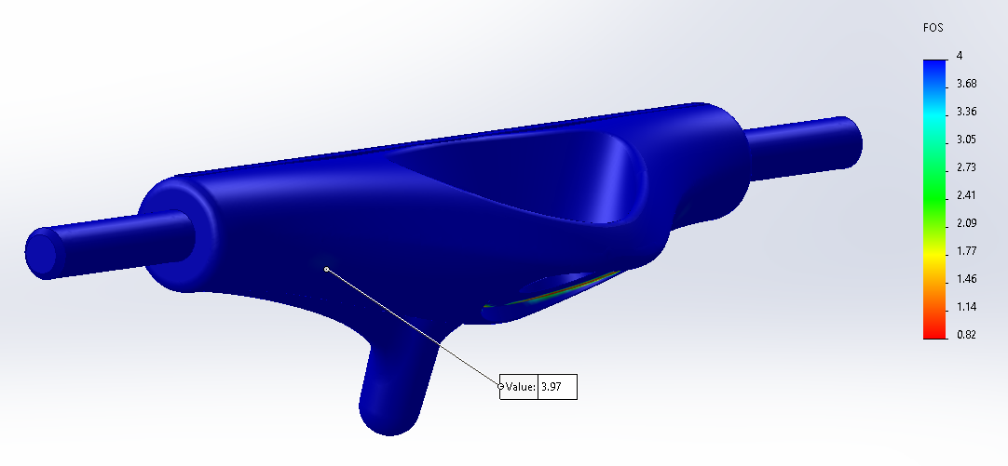
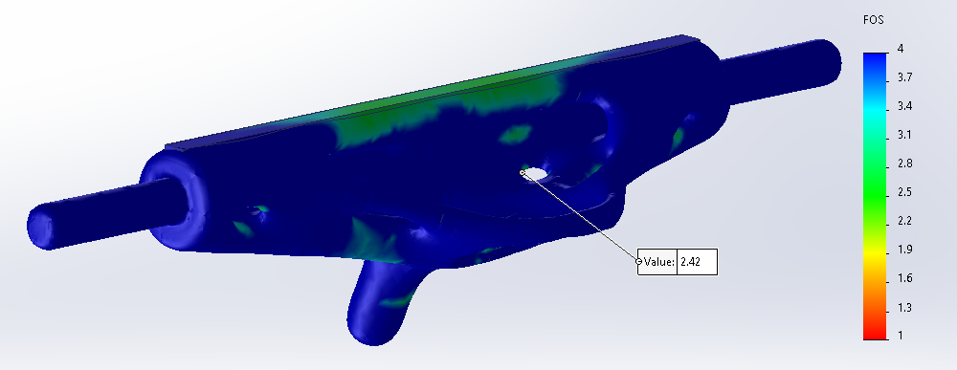
Final Hanger Factor of Safety FEA
Figure 25: Original Hanger FOS
Figure 26: Optimized Hanger FOS (59.7%)
Notes:
Overview:
Installing and Troubleshooting a M100LabR Concept Laser PBF Printer
Printing and evaluating parts and specimens (ie Stress-Strain, Thermal Management)
Creation of a user manual and short curriculum for ME286L
Included is the printer itself, powder mixer, powder trolley, and various powdered alloys for use with the printer
Location of set-up: CEIAS IDEA Lab, Room 116A

Slide 29
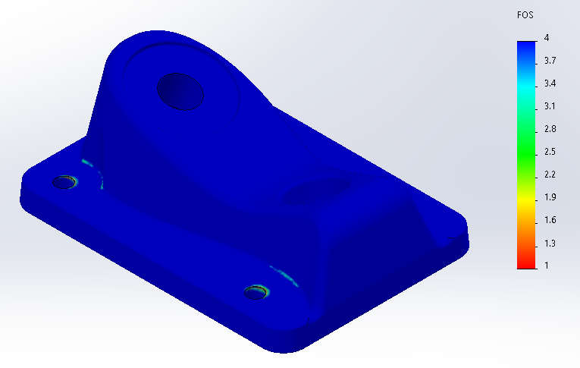
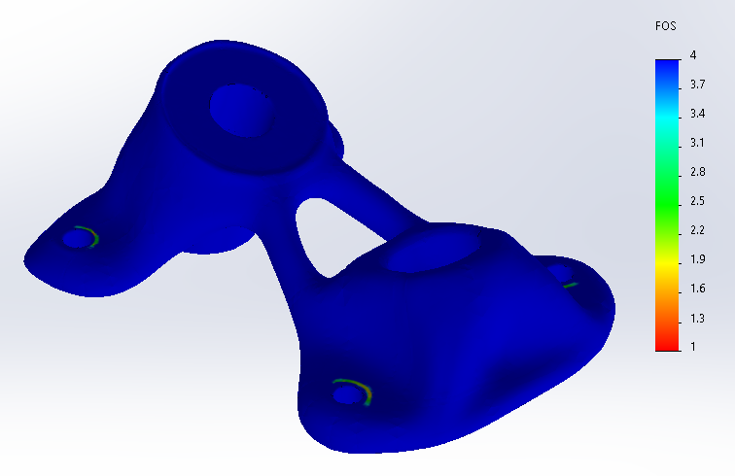
Final Baseplate Factor of Safety FEA
Figure 27: Original Baseplate FOS
Figure 28: Optimized Baseplate FOS (52.4%)
Notes:
Overview:
Installing and Troubleshooting a M100LabR Concept Laser PBF Printer
Printing and evaluating parts and specimens (ie Stress-Strain, Thermal Management)
Creation of a user manual and short curriculum for ME286L
Included is the printer itself, powder mixer, powder trolley, and various powdered alloys for use with the printer
Location of set-up: CEIAS IDEA Lab, Room 116A

Slide 30
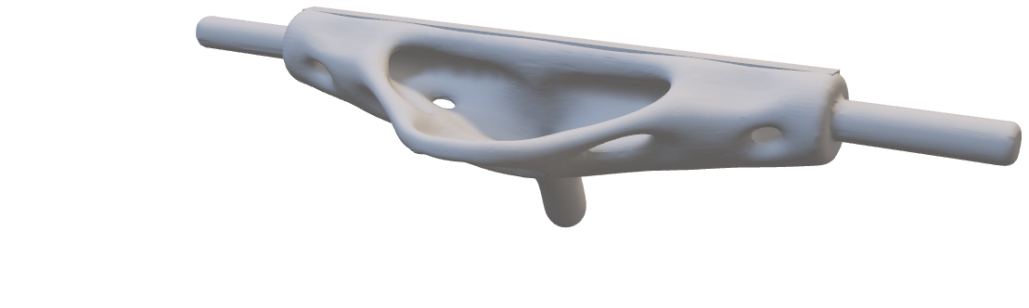
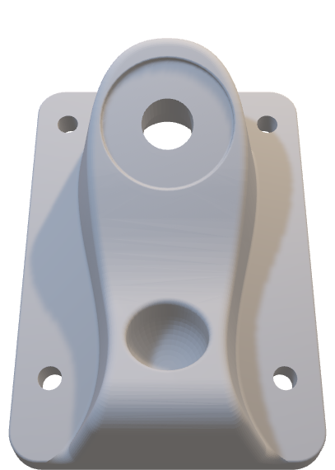
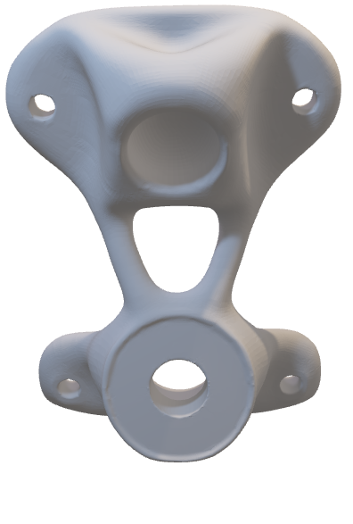
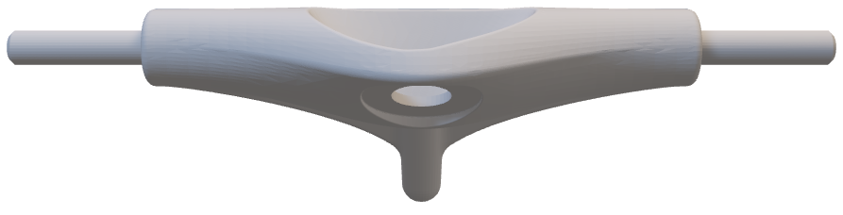
Final Optimization
Optimized Baseplate 52.4%
Optimized Hanger 59.7%
Notes:
Overview:
Installing and Troubleshooting a M100LabR Concept Laser PBF Printer
Printing and evaluating parts and specimens (ie Stress-Strain, Thermal Management)
Creation of a user manual and short curriculum for ME286L
Included is the printer itself, powder mixer, powder trolley, and various powdered alloys for use with the printer
Location of set-up: CEIAS IDEA Lab, Room 116A

Slide 31
Testing, Results, and Project Outcomes
Section 2:

Slide 32
Top Level Testing Summary
Table 3: Top Level Testing Summary
EXP1 – Test Print
Gas Leak Test
Build Module Trials
Shim Alignment
Test Print and Tolerance
EXP2 – Tensile Test
Tensile test machined specimen alongside printed specimen and compare
Experiment/Test | Relevant DRs | Testing Equipment Needed | Other Resources
EXP1 - Test Print | ER - Final Print Material (SS 316L) ER - Power ER - Inert Gas ER - Airtight Gas Supply ER - Build Plate Alignment ER - Printed Part Tolerance (±0.2mm) CR - Safety CR - Successful Installation CR - Final Part and Assembly CR – Time | Small tube Dial gauge indicator Shim Calipers | Rail system to slide dial gauge indicator along build module
EXP2 - Tensile Test | ER - Final Print Material (SS 316L) ER - Young's Modulus Tested ER - Dog Bone Size CR - Tensile Test Results CR – Time | Tensile test equipment Calipers
Notes:
Overview:
Installing and Troubleshooting a M100LabR Concept Laser PBF Printer
Printing and evaluating parts and specimens (ie Stress-Strain, Thermal Management)
Creation of a user manual and short curriculum for ME286L
Included is the printer itself, powder mixer, powder trolley, and various powdered alloys for use with the printer
Location of set-up: CEIAS IDEA Lab, Room 116A

Slide 33
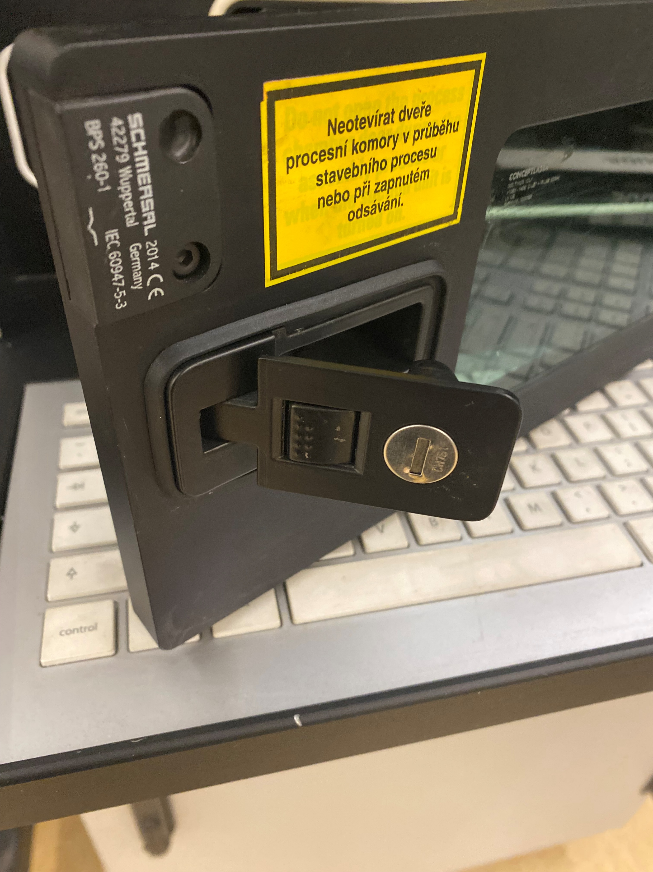
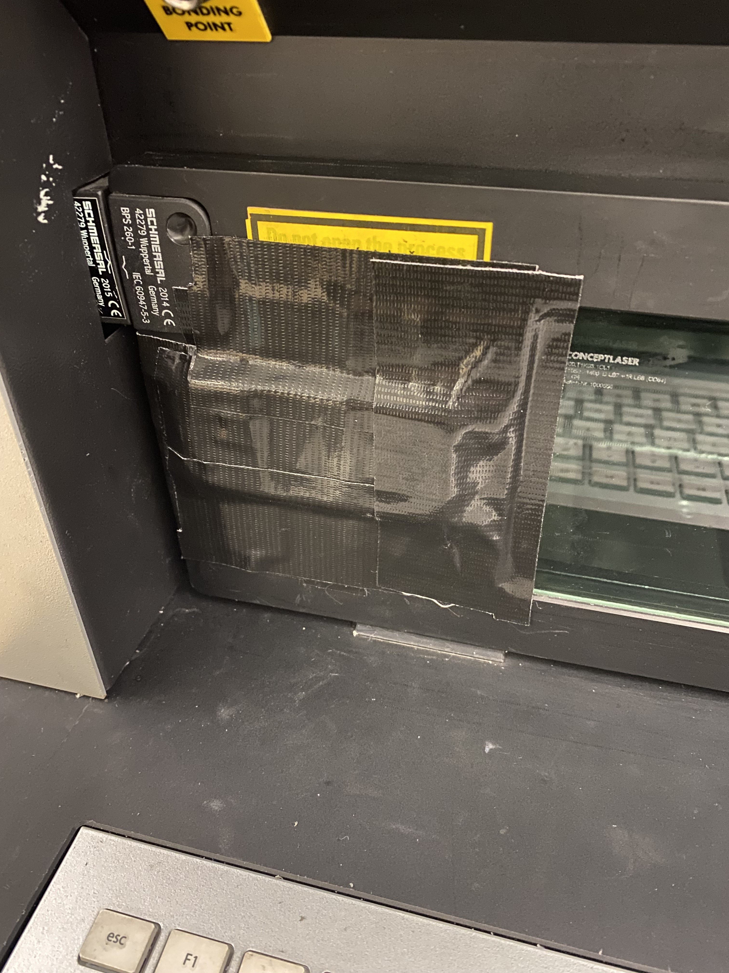
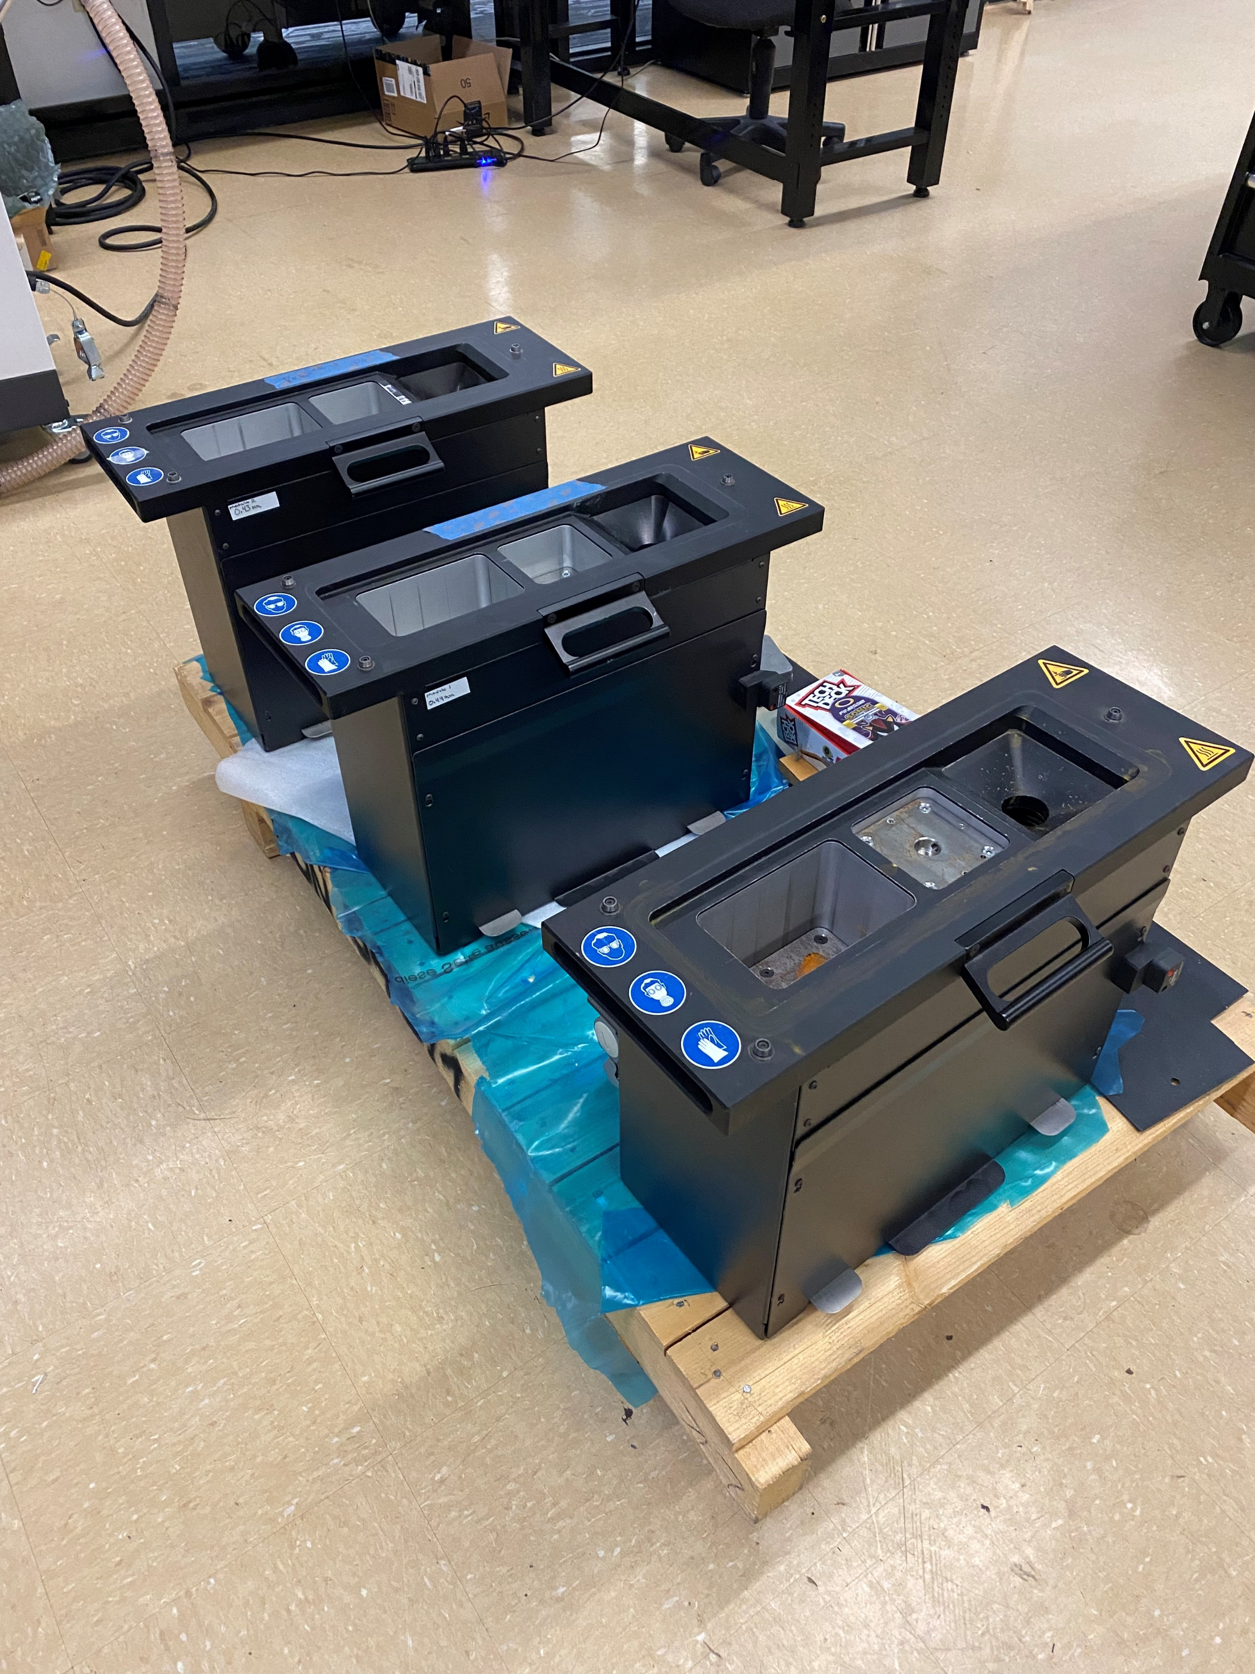
EXP1 Plans/Results
EXP1.1 – Gas Leak Test (50%)
Using 1” copper tube to detect audible leakage around gas tank, supply hose, and build chamber door.
Fixed with duct tape, no audible leakage, waiting on replacement latch
EXP1.2 – Build Module Trials (100%)
Testing remaining 4 build modules for operation and alignment.
All modules tested
Figure 29: Door Seal Latch
Figure 30: Duct Taped Door Seal Latch
Figure 31: Build Modules
Notes:
Overview:
Installing and Troubleshooting a M100LabR Concept Laser PBF Printer
Printing and evaluating parts and specimens (ie Stress-Strain, Thermal Management)
Creation of a user manual and short curriculum for ME286L
Included is the printer itself, powder mixer, powder trolley, and various powdered alloys for use with the printer
Location of set-up: CEIAS IDEA Lab, Room 116A

Slide 34


EXP1 Plans/Results Cont.
EXP1.3 – Shim Alignment (100%)
Build plate leveled, shimming process optimized.
Must be leveled between each print.
Field service required to fix build chamber z-axis elevator.
Figure 32: Test Shims
Figure 33: Level Build Plate
Notes:
Overview:
Installing and Troubleshooting a M100LabR Concept Laser PBF Printer
Printing and evaluating parts and specimens (ie Stress-Strain, Thermal Management)
Creation of a user manual and short curriculum for ME286L
Included is the printer itself, powder mixer, powder trolley, and various powdered alloys for use with the printer
Location of set-up: CEIAS IDEA Lab, Room 116A

Slide 35


EXP1 Plans/Results Cont.
EXP1.4 – Test Print and Tolerance (100%)
Benchy printed successfully, tolerance of ±0.2mm achieved.
Major dimensions compared to those from the Benchy website.
Model was scaled down to 62% for the print, and expected values are 62% of original model values.
Table 4: Benchy Tolerance test
Figure 34: Benchy Print
Part | Dimension | Expected (mm) | Actual (mm) | Difference (mm)
Overall | Width | 19.22 | 19.04 | 0.18
 | Length | 37.2 | 37.24 | -0.04
Roof | Length | 14.26 | 14.13 | 0.13
Cargo | Width | 7.44 | 7.27 | 0.17
Figure 35: Tolerance Testing
Notes:
Overview:
Installing and Troubleshooting a M100LabR Concept Laser PBF Printer
Printing and evaluating parts and specimens (ie Stress-Strain, Thermal Management)
Creation of a user manual and short curriculum for ME286L
Included is the printer itself, powder mixer, powder trolley, and various powdered alloys for use with the printer
Location of set-up: CEIAS IDEA Lab, Room 116A

Slide 36



Detailed Testing Plans
EXP2 – Tensile Test
EXP2 – Tensile Test (100%)
Tensile test specimen are placed in the device, then are slowly strained using increasing force until failure.
EXP2.1 (100%)
Machined specimens tested in room 101, tensile testing following E8/E8M and results graphed.
EXP2.2 (100%)
Printed specimen tested in room 100, similarly following E8/E8M and results graphed.
Figure 36: Testing Animation
Figure 37: Machined and Printed Specimen
Notes:
Overview:
Installing and Troubleshooting a M100LabR Concept Laser PBF Printer
Printing and evaluating parts and specimens (ie Stress-Strain, Thermal Management)
Creation of a user manual and short curriculum for ME286L
Included is the printer itself, powder mixer, powder trolley, and various powdered alloys for use with the printer
Location of set-up: CEIAS IDEA Lab, Room 116A

Slide 37
EXP2 Results
Table 5: Tensile Test Results
Specimen Name | Max Engineering Stress [GPa] | Young's Modulus [GPa] | Yield Strength [MPa]
No Color Subtractive | 0.7642 | 96.9440 | 331.5659
Blue Subtractive | 0.8122 | 84.2820 | 412.3016
Jim Subtractive | 0.8970 | 82.5530 | 544.9523
No Color Additive | 0.8362 | 83.1530 | 504.0858
Blue Additive | 0.8779 | 82.0070 | 553.3102
Black Additive | 0.8623 | 83.5080 | 509.1423
Subtractive Avg. | 0.8245 | 87.9263 | 429.6066
Subtractive Range | 0.1329 | 14.3910 | 213.3864
Standard Deviation | 0.0673 | 7.8572 | 107.7406
Max | 0.8970 | 96.9440 | 544.9523
Additive Avg. | 0.8588 | 82.8893 | 522.1795
Additive Range | 0.0417 | 1.5010 | 49.2244
Standard Deviation | 0.0211 | 0.7845 | 27.0783
Max | 0.8779 | 83.5080 | 553.3102
Notes:
Overview:
Installing and Troubleshooting a M100LabR Concept Laser PBF Printer
Printing and evaluating parts and specimens (ie Stress-Strain, Thermal Management)
Creation of a user manual and short curriculum for ME286L
Included is the printer itself, powder mixer, powder trolley, and various powdered alloys for use with the printer
Location of set-up: CEIAS IDEA Lab, Room 116A

Slide 38
EXP2 Results
Graph 1: Tensile Testing
Notes:
Overview:
Installing and Troubleshooting a M100LabR Concept Laser PBF Printer
Printing and evaluating parts and specimens (ie Stress-Strain, Thermal Management)
Creation of a user manual and short curriculum for ME286L
Included is the printer itself, powder mixer, powder trolley, and various powdered alloys for use with the printer
Location of set-up: CEIAS IDEA Lab, Room 116A

Slide 39
Specification Sheets
ER Summary Table
Engineering Requirement | Target | Tolerance | Measured/Calculated Value | ER met? (Yes or No) | Client Acceptable (Yes or No)
Materials Tested | One | N/A | One | Y | Y
Final Print Material | SS 316L | N/A | SS 316L | Y | Y
Final Print Volume | <90x90x80 | No Tolerance | <90x90x80 | Y | Y
Power | 240V, 16A | >=240V | 240V, 16A | Y | Y
Inert Gas | 2 bar Ar purity >=2.5 | No Tolerance | 2 bar Ar purity >=2.5 | Y | Y
Young's Modulus Tested | 193 | N/A | Subtractive: 87.9263 Additive: 87.9263 | N | Y
Dog Bone Size | 65 | +-0.1mm | 65 | Y | Y
Airtight Gas Supply | No audible leak | No Tolerance | No audible leak | Y | TBD
Build Plate Alignment | Even material distribution | No Tolerance | Even material distribution | Y | TBD
Printed Part Tolerance | ±0.2mm | Same as Target |  | Y | Y
CR Summary Table
Customer Requirement | CR Met? (Yes or No) | Client Acceptable (Yes or No)
Ease of Use | Y | Y
Safety | Y | Y
Time | Y | TBD
Successful Installation | Y | Y
Tensile Test Results | Y | Y
Final Part and Assembly | N | TBD
Instruction Manual | N | TBD
Notes:
Overview:
Installing and Troubleshooting a M100LabR Concept Laser PBF Printer
Printing and evaluating parts and specimens (ie Stress-Strain, Thermal Management)
Creation of a user manual and short curriculum for ME286L
Included is the printer itself, powder mixer, powder trolley, and various powdered alloys for use with the printer
Location of set-up: CEIAS IDEA Lab, Room 116A

Slide 40



Final Progress
Done:
Machine installed and connected to both a power and gas supply
Machine operating as intended
Operation process optimized and repeatable
Safety procedures for IDEA Lab established
Printing parameters for 316L stainless steel solidified
Need to Do:
Print final optimized parts and assemble
Write “first print” instruction manual
Figure 39: Test Specimen Print
Figure 38: Printer Setup
Figure 40: Benchy Print
Notes:
Overview:
Installing and Troubleshooting a M100LabR Concept Laser PBF Printer
Printing and evaluating parts and specimens (ie Stress-Strain, Thermal Management)
Creation of a user manual and short curriculum for ME286L
Included is the printer itself, powder mixer, powder trolley, and various powdered alloys for use with the printer
Location of set-up: CEIAS IDEA Lab, Room 116A

Slide 41


Future Work
Order Colibrium Additive field service for maintenance check and build module z-axis elevator upgrade
Replace build chamber door latch
Establish post-processing methods with machine shop
Print with more reactive materials like Titanium and Aluminum
Explore more complex geometry and lattice structures with Autodesk NetFabb
Print atop machined parts
Figure 41: Advanced Additive Part
Figure 42: Sandblasting a Part
Notes:
Overview:
Installing and Troubleshooting a M100LabR Concept Laser PBF Printer
Printing and evaluating parts and specimens (ie Stress-Strain, Thermal Management)
Creation of a user manual and short curriculum for ME286L
Included is the printer itself, powder mixer, powder trolley, and various powdered alloys for use with the printer
Location of set-up: CEIAS IDEA Lab, Room 116A

Slide 42

Thank You!
Any Questions?

